Slide 1
Voting with a Disability in Florida
Tuesday, September 17th, 2024 at 11 AM

Slide 2
Accessibility

Slide 3
Caption Options & ASL
Closed Captions: CC button at the bottom of the screen
External Caption Viewer: Link provided in the chat
ASL Interpreters: Spotlighted on your screen

Slide 4
Submitting Questions & Recording
Q and A button: Located at the bottom of the screen
  Email: Webinar@DisabilityRightsFlorida.org
You can submit questions at any time. We will answer them at the end.
This webinar will be recorded and posted on our website and YouTube channel.
No certificates or credits will be provided.

Slide 5
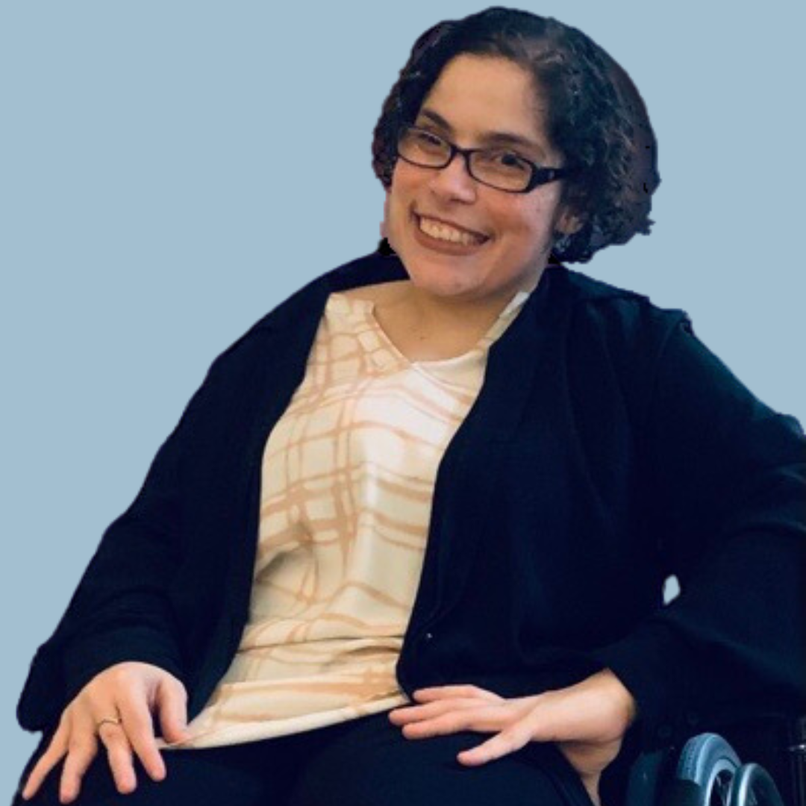
Introductions
Laura-Lee Minutello is the Public Policy Analyst at Disability Rights Florida, as well as a self-advocate with Cerebral Palsy. In addition to working on DRF’s broader policy agenda, Laura began her career at DRF as the agency’s Voting Access Advocate and currently oversees DRF’s voting work- helping to protect the right to private and independent access to the ballot box for Floridians with disabilities. She holds a Bachelor of Science in Psychology from the University of Central Florida, and is working toward a Master’s of Nonprofit Management, also from UCF.

Slide 6
Agenda
About Disability Rights Florida
Important Deadlines and Our Hotline
How to vote in person and by mail
Congregate Voting & Rights Restoration
Supervised Facility Voting (SFV)
How to submit a voting access complaint
Q&A

Slide 7
About Disability Rights Florida (DRF)
Florida’s designated Protection and Advocacy System (P&A)
Our mission: To advocate, educate, investigate, and litigate to protect and advance the rights, dignity, equal opportunities, self-determination, and choices for all people with disabilities
Funding, responsibility, and authority under nine federal grants to protect the rights of Floridians with disabilities since 1977
DRF has access authority to any agency, institution, and organization that serves or houses people with disabilities. This is a power that other agencies do not have.

Slide 8
Important Deadlines and Our Hotline

Slide 9
Important Dates and Deadlines
October 7 - Deadline to register to vote
October 24 - Deadline to request vote-by-mail ballot
October 25 - Early Voting begins
October 29 - Deadline to send back vote-by-mail ballot through the mail to make it to your SOE in time
November 2 - Early Voting Ends
November 5 - Deadline to drop off vote-by-mail ballot to SOE (before office closes)
November 5, 2024 - Election Day

Slide 10
Disability Voting Rights Hotline
877-352-7337

Slide 11
Laws that Protect Disabled Voters

Slide 12
Rights & Resources
Voters with disabilities have a right to:
Vote privately and independently.
Utilize accessible poll sites, voter registration systems, vote-by-mail balloting and other ballot casting devices.
Receive assistance from any person of your own choosing (other than employer or a union representative) to cast a ballot.
These rights are protected by the following federal laws as well as related state law:
The Americans with Disabilities Act (ADA)
The Voting Rights Act of 1965
The Voting Accessibility for the Elderly and Handicapped Act of 1984
The National Voter Registration Act of 1993

Slide 13
Voting in Person

Slide 14
How to Vote in Person
You can vote in person during Early Voting or on Election Day. You can vote early at any open location in your county, but you will need to vote at your assigned polling place on election day.
Bring a photo ID that has your signature on it.
You can bring a sample ballot that you have filled out in advance or a piece of paper that includes the details of who and what you want to vote for.
There must be at least one voting machine in every polling place that's accessible to anyone who has a disability.

Slide 15
Voter ID Needed in Florida
Accepted IDs
Your ID must have your signature on it.
  If it doesn’t have your signature (like a passport card), bring an extra document that does. This extra ID document does not need a photo.
Must be unexpired
Florida driver’s license
Florida state ID card
US passport or passport card
Military identification
Student ID
Public assistance ID
Veterans Health ID card issued by US Dept of Veterans Affairs
Retirement center ID
Neighborhood association ID
Debit or credit card
Florida concealed weapon license
Employee ID issued by US, Florida, or local government

Slide 16
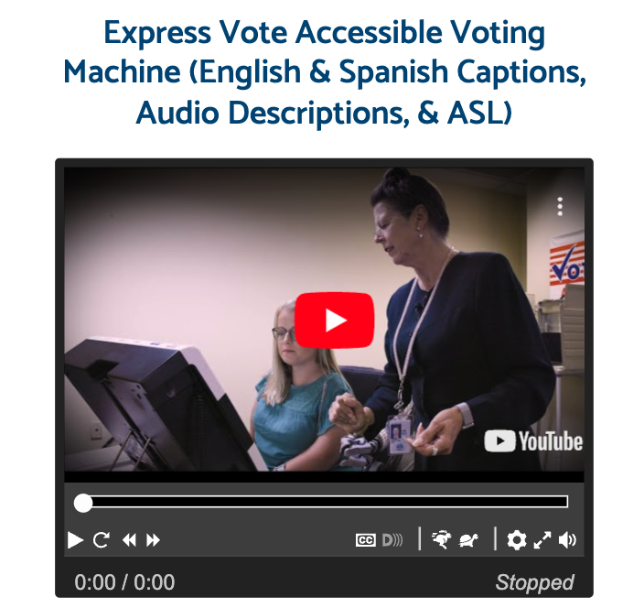
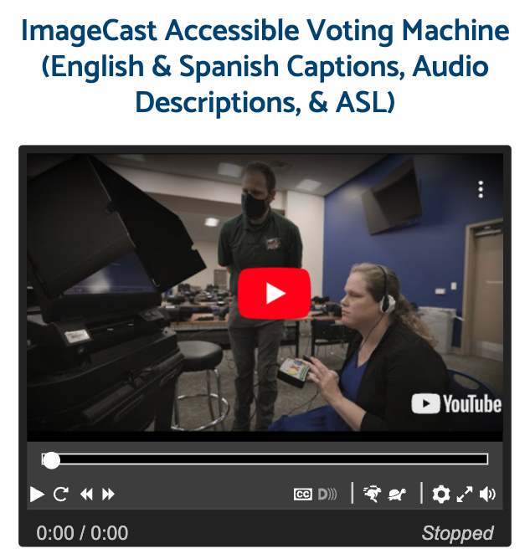
Accessible Voting Machines

Slide 17
Voting by Mail

Slide 18
How to Vote-By-Mail (1/2)
Every Floridian who has a right to vote is allowed to vote-by-mail.
You have 2 options: standard vote-by-mail or accessible vote-by-mail!
You must request a new vote-by-mail ballot each year.

Slide 19
How to Vote-By-Mail (2/2)
You must be registered to vote.
You must contact the Supervisor of Elections Office in the county where you live and ask for a vote-by-mail ballot at least 12 days before an election.
For accessible vote-by-mail:
  You must also ask for a remote access vote-by-mail ballot. You will receive the standard paper ballot AND the accessible ballot in your email.
  Fill out the accessible ballot, print it out, and return it to your Supervisor of Elections Office, either through the mail or in person.
  Yes – you need to print it yourself, either at home or a secure place.

Slide 20
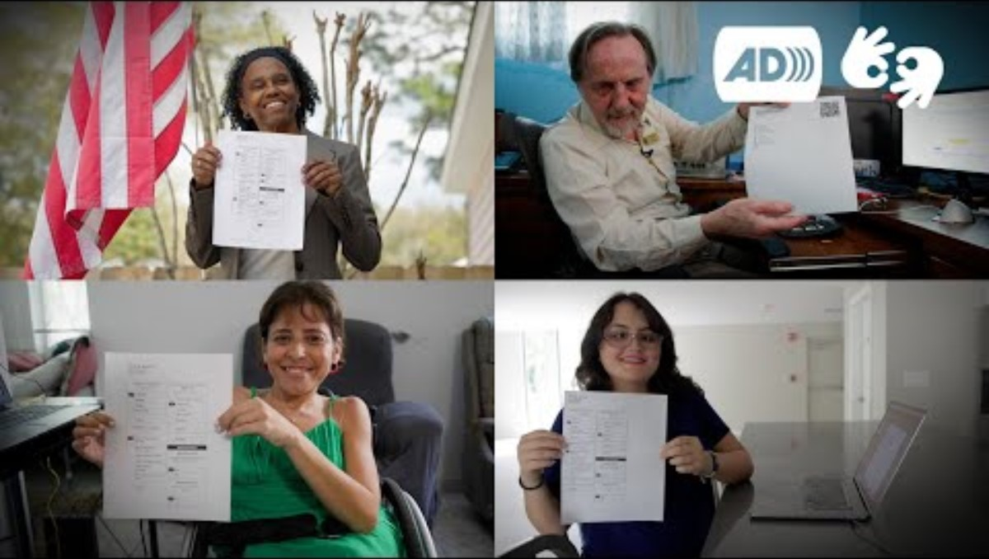
[AD] [ASL] How to Use Florida's Accessible Vote-by-Mail

Slide 21
Congregate Voting & Rights Restoration

Slide 22
Congregate Facility Voting Rights
Florida allows people living in nursing homes and assisted living facilities (ALFs) to request what the law calls Supervised Facility Voting (SFV).
This means that if five or more residents ask the administration of a facility to vote, and the administrator contacts the supervisor of elections in their county, the supervisor will have staff go to the facility and residents can cast their ballots there.
Currently, Supervised Facility Voting only applies to nursing homes and ALFs, but unless they have been removed, voting rights are also protected in other types of facilities, including group homes, intermediate care facilities, treatment facilities, and jails.

Slide 23
Rights Removal
A person may not have the right to vote when they have:
A plenary guardianship. If a person is under limited guardianship, the guardianship order must state that the right to vote has been removed.
A felony conviction in Florida for murder or a sexual offense, unless and until the person's right to vote is restored by the State Clemency Board.
A felony conviction in Florida where the terms of a sentence, including payment of fines is not complete.
A felony conviction in another state which would remove voting rights in that state.
If you have a right to vote – you can vote and should vote for whoever you want.

Slide 24
Supervised Facility Voting (SFV)

Slide 25

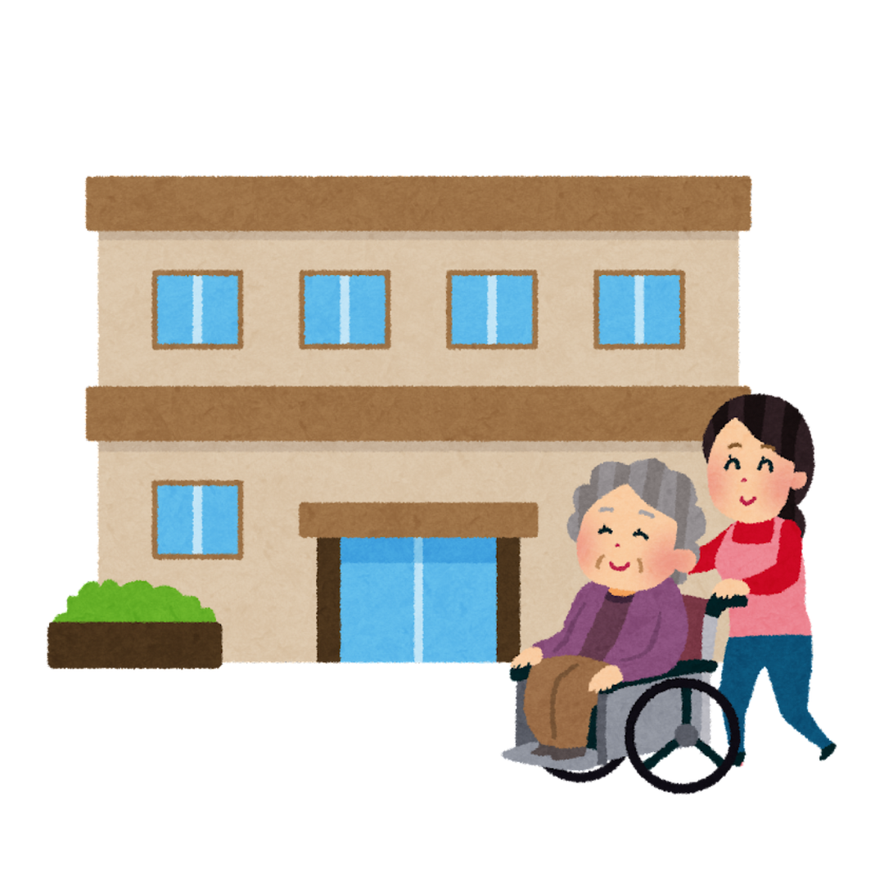
What is Supervised Facility Voting?
Supervised facility voting is a way that people living in nursing homes and assisted living facilities can vote. Staff from your county’s Supervisor of Elections office will come to your facility, bring you your ballot, assist you with voting, and take your ballot back with them to be counted.

Slide 26

SFV – Register to Vote-by-Mail
First, you have to be registered to vote-by-mail.
Because you are not voting at a poll site, you must register to vote-by-mail.
When the election staff comes to do the supervised facility voting, they will bring you your ballot.
If you are not registered to vote-by-mail, they will not bring you a ballot.
You can check your registration status at RegisterToVoteFlorida.gov.

Slide 27
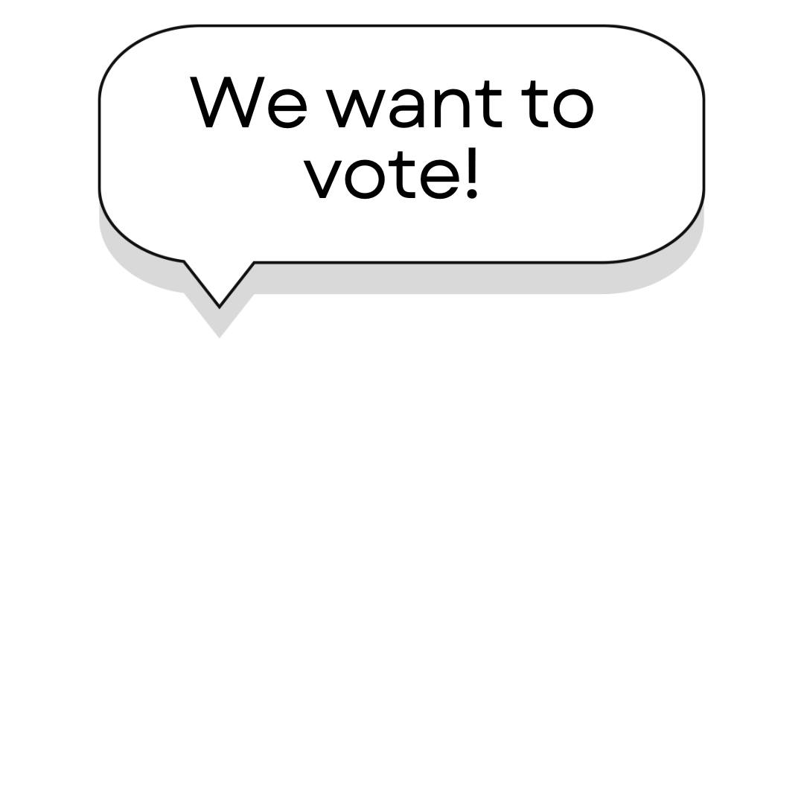
SFV – Tell admin you want to vote!
At least five people (including yourself) must want to vote in order for supervised facility voting to happen. Only when five people want to vote can your facility’s administrator ask the Supervisor of Elections to come to you with your ballots.
It is important to tell the administrator where you live that you want to vote so they can contact the Supervisor of Elections as soon as possible. You need to ask them to come to where you live. Your administrator needs to contact the Supervisor of Elections office at least 4 weeks (28 days) before election day.
The supervisor of elections and your facility's administrator will choose the date and time that the voting will happen.

Slide 28

SFV on Voting Day (1/2)
Staff from your county’s Supervisor of Elections office will come to your facility, bring your ballot, assist you with voting, and take your ballot back with them to be counted.
At least two SOE staff members will be there.
  In a primary election, SOE staff members from the same political party being voted on will be there. For example, in a Republican primary, Republican SOE staff members will come to do the supervised facility voting.
  In an election where there is more than one political party on the ballot, SOE staff will be from more than one political party. For example, in a general Presidential election, you could have Republican, Democrat, and Independent SOE staff come to do the supervised facility voting.

Slide 29

SFV on Voting Day (2/2)
The SOE staff will give you your ballot to vote.
If you need help voting, the SOE staff can help you. Or, you can ask someone else you trust.
If you decide not to vote that day or cannot vote that day, you still have the right to vote later with the assistant of your choice.

Slide 30
Making a Voting Access Complaint

Slide 31
What is the Help America
Vote Act (HAVA)?
The Help America Vote Act (HAVA) did a few things to help people with disabilities vote.
HAVA guarantees people with disabilities the right to vote privately and independently.
HAVA also requires at least one accessible voting machine at each voting site.
It also made voting systems follow a few rules to help you vote.
If you experience issues while voting, you can file a HAVA complaint.

Slide 32

How to File a Complaint
If you face problems with the voting process, you can submit a complaint.
The complaint form is on the Florida Department of State website in both English and Spanish.
The complaint form has three parts.

Slide 33
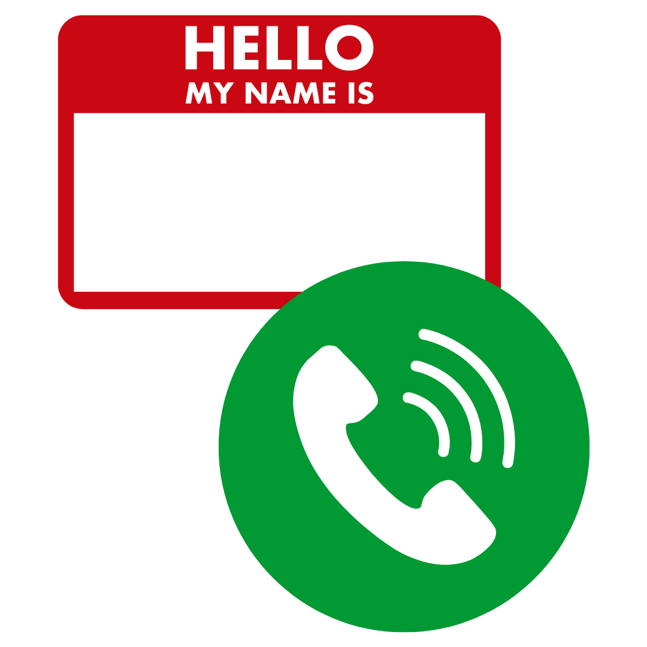
Part 1: Contact Information
On the form, it says, ‘Person Bringing Complaint’ and ‘Person or Entity Against Whom Complaint is Brought’
You are the ‘Person Bringing Complaint.’ Add Your Name, phone, and address in this section.
Next, add the contact information for the person or entity you are complaining about for ‘Person or Entity Against Whom Complaint is Brought.’ Usually, people write the Secretary of State because the Secretary of State’s job is to confirm election results.

Slide 34

Part 2: Describe the Violation
Write what happened, or what the person or place you're complaining about did. This should be the same person or place you listed above.
Tell them specific things they did, or may do, that you think are against the law.

Slide 35

Part 3: Statement of Facts
This is the longest and most important part of the form.
This is where you talk about what happened at the poll site. Include relevant information about the issue.
  What day was it?
  What time was it?
  Where did it happen?
  Who was there? If possible, share people’s names and phone numbers. These can be people who saw your issue happen, or other people who faced the same issue are you.

Slide 36

Filing the Complaint
You must handwrite your complaint.
If you cannot write, you can have someone write it for you, but afterwards you must take it to a notary and sign it there. The notary will make it an official document that you can submit.
You can submit your complaint to either the Florida Division of Elections or your local county election office.

Slide 37
After You Submit the Complaint (1/2)
The Department of State will decide if your complaint showed a violation of the law.
If you disagree with their opinion, you can request a hearing on the record.
  This means you are asking for an explanation about the result.
  You are asking them to look deeper into the issue.
The Department of State will gather information from everyone about the incident.
Once they get all the information, the state will determine if there is a violation or not.

Slide 38
After You Submit the Complaint (2/2)
If a violation of the law happened → the state will work to fix it.
If a violation of the law didn’t happen → the state will dismiss the complaint and post their decision online.
Once you file the complaint, the state has 90 days to make a decision.
  If they don’t make a decision within those 90 days, they will ask you if they can have more time to investigate. Only you can extend the deadline (more than 90 days).
  If you do not extend the deadline, the state has 60 days to come to a compromise with you. This is called an alternative dispute resolution, and a judge will make a decision.

Slide 39
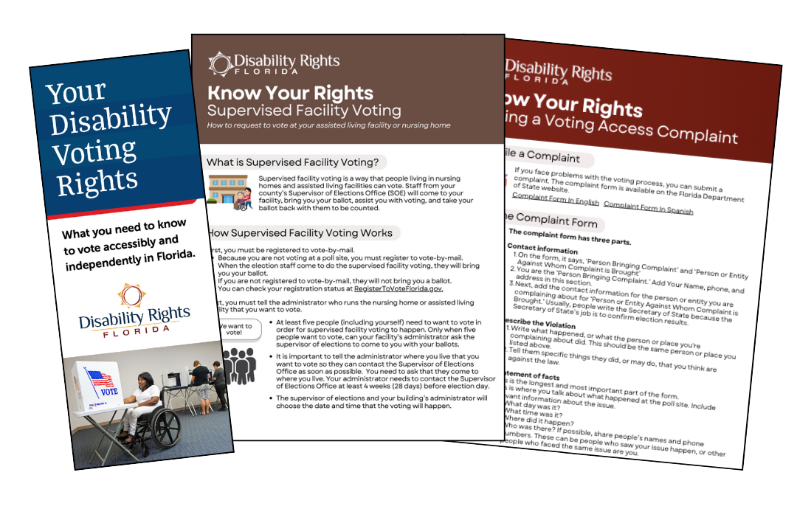
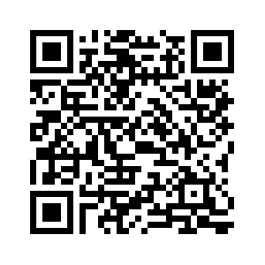
DRF Voting Resources & Videos
DisabilityRightsFlorida.org/voting

Slide 40
Voting Resources
Register to vote: RegisterToVoteFlorida.gov
Find your Supervisor of Elections: Dos.Elections.MyFlorida.com/Supervisors/
Find your Poll Site: bit.ly/4gyeN0u
Request a new vote-by-mail ballot: bit.ly/3ItQnpX
DRF's Voting Resources: DisabilityRightsFlorida.org/voting
AAPD's State Voting Guide: www.aapd.com/voter-info
New Disabled South's Florida Voting Checklist + Deadlines: www.newdisabledsouthrising.org/florida-voting

Slide 41
Questions?

Slide 42
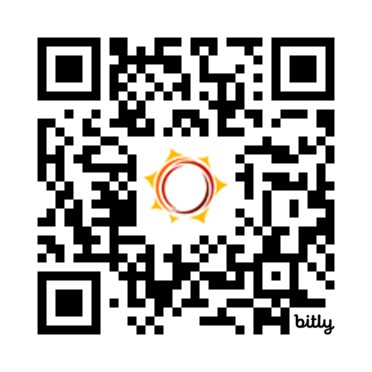
Thank You & Feedback Survey
Follow Disability Rights Florida on social media
Facebook: DisabilityRightsFlorida
Instagram: DisabilityRightsFL
LinkedIn: disability-rights-florida
YouTube: DisabilityRightsFL
Tiktok: DisabilityRightsFL
Twitter/X: DisabilityRtsFL
bit.ly/drf_training
Presentation Code: ZW5

