Slide 1
Hurricane and Disaster Preparedness for People with Disabilities
Tuesday, July 16, 2024
11 am - 12 noon

Slide 2
Accessibility

Slide 3
Live Captions Options
Closed Captions: CC button at the bottom of the screen
External Caption Viewer: Link provided in the chat.

Slide 4
Submitting Questions
Q and A button: Located at the bottom of the screen
Email: Webinar@DisabilityRightsFlorida.org
You can submit questions at any time. We will answer them at the end.

Slide 5
Live Tweeting & Sharing
Hashtags:
#DisabilityRightsFlorida #DisasterPrep #HurricanePrep
Twitter Tag:
@DisabilityRtsFL @DisasterStrat

Slide 6


Introductions
Bryan Russel (he/him), Emergency Management Coordinator
Disability Rights Florida
Shaylin Sluzalis (she/ella), Co-Executive Director at The Partnership for Inclusive Disaster Strategies

Slide 7
Agenda
FEMA 2024 Individual Assistance Reforms
  FEMA Individual Assistance (IA) program
  Recent changes to FEMA IA
  How to apply for FEMA disaster assistance
Housing
  Evacuating with a disability
  Shelters
Self-Advocacy and Planning
Resources

Slide 8
What is FEMA and FEMA's Individual Assistance?

Slide 9
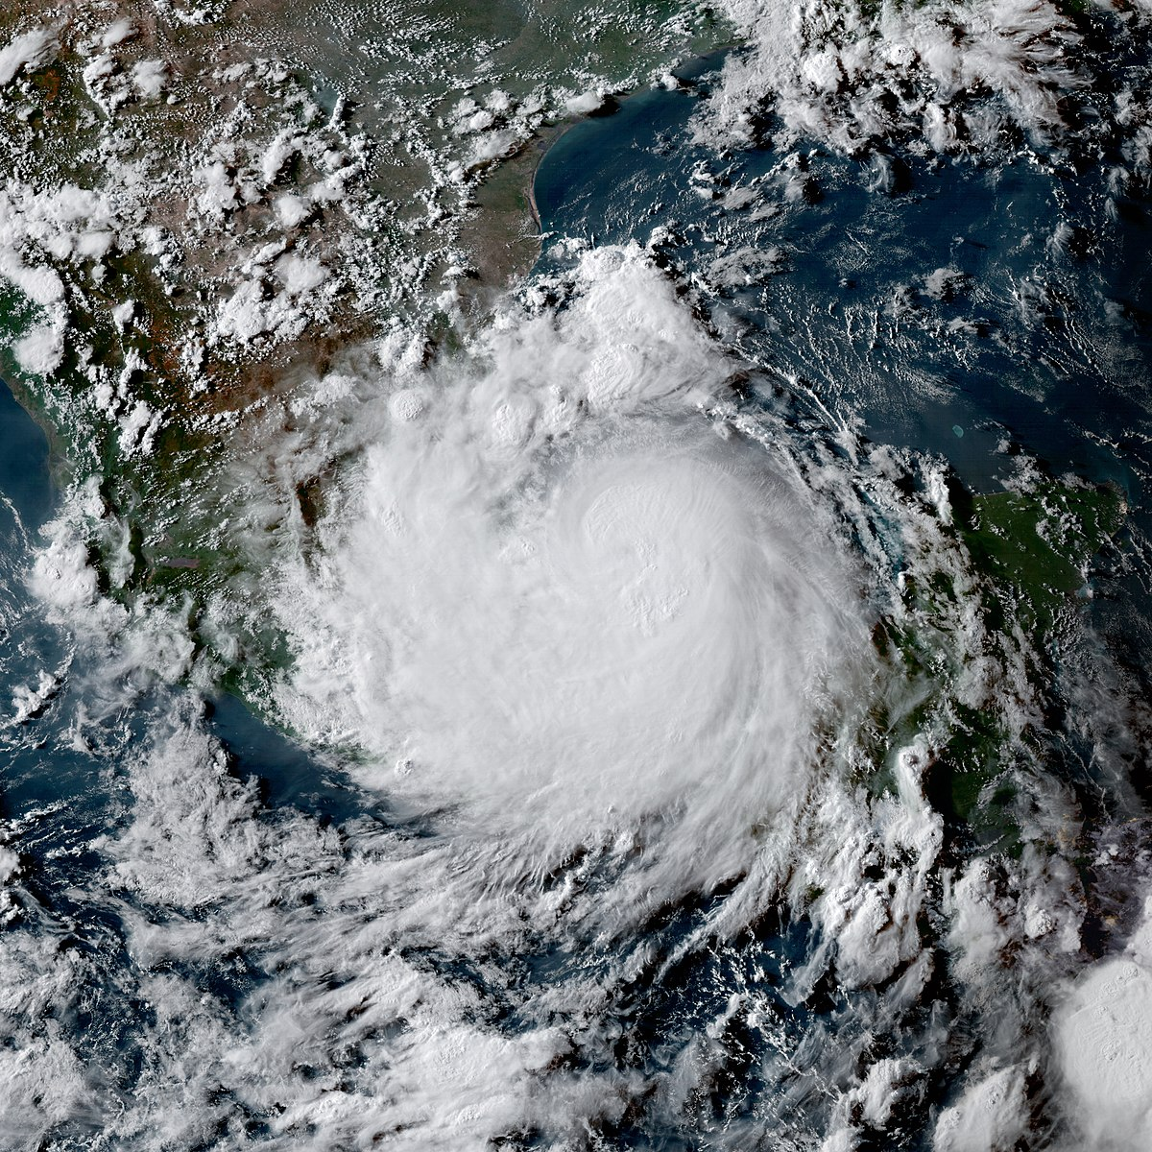

What is FEMA?
FEMA stands for Federal Emergency Management Agency (FEMA)
FEMA helps people before, during and after disasters, such as hurricanes, tornadoes, floods, and more.
ThePhoto by PhotoAuthor is licensed under CCYYSA.
ThePhoto by PhotoAuthor is licensed under CCYYSA.

Slide 10
FEMA Individual Disaster Assistance
After a disaster, FEMA offers services to individuals and households.
These services include:
  Financial assistance
  Temporary housing
  Crisis counseling
  Disaster case management
  Legal services
  Unemployment assistance
  And more

Slide 11
Changes to FEMA Assistance as of March 22, 2024

Slide 12
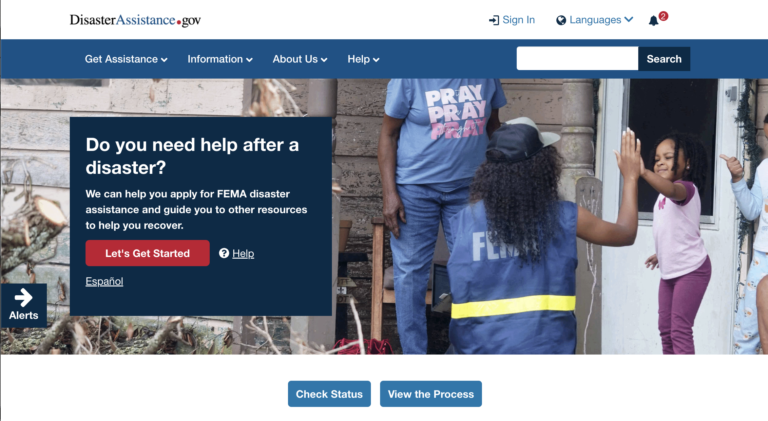
DisasterAssistance.gov
Updates to DisasterAssistance.gov
  Reimagined website design
  Faster application process
  Easy navigation
  Visual progress tracking
  Individualized information collection
Expected reduction in registration time by more than 15%

Slide 13

Simplifying the application and appeals process
Removing barriers for late applications
Streamlining Temporary Housing Assistance application by reducing documentation requirements
Survivors who wish to appeal FEMA’s decisions on their eligibility will no longer need to provide a signed, written appeal letter to accompany the supporting documentation.

Slide 14
FEMA and Small Business Administration (SBA)
No longer need to apply / be denied through Small Business Administration (SBA) before receiving FEMA assistance.
Before, you had to apply through SBA to qualify for FEMA assistance.
Now, you only apply to SBA if you have a small business and need a loan. All other applicants apply directly to FEMA for assistance.

Slide 15
Serious Needs Assistances
“Serious needs assistance” ($750 cash assistance for survivors) will be automatically included when a state or territory requests a presidential declared disaster.
Before, when a state or territory requested a declaration, they would have to request critical needs assistance to be included in their package.
Now, serious needs assistance will be automatically included when states/territories request Federal assistance. Meaning all eligible survivors will have quicker access to immediate cash assistance.

Slide 16
Expanding 'Habitability' Definition
FEMA is simplifying its definition of “habitability” to broaden eligibility to include repairs to homes with pre-existing conditions.
Before, you were only eligible for reimbursement related to damage caused by the disaster, not prior damage to an area of the house.
Now, you may be eligible for reimbursements of damages that were there prior (i.e. a leaky roof prior to disaster)

Slide 17
Helping Underinsured Survivors
Streamlining insurance-related rules to help survivors who do not receive enough assistance from their insurance company to cover their rebuilding costs.
Before, if a survivor received $42,500 from their insurance company (the 2024 max), a household was ineligible to receive additional assistance from FEMA.
Now, assistance is available up to the $42,500 cap, to cover costs not reimbursed by insurance including deductibles and underinsured losses.

Slide 18
Displacement Assistance (1/2)
Provides eligible survivors with up-front funds to assist with immediate housing options of their choice.
Such as costs associated with staying with family and friends until they are able to secure a rental option to focus on their long-term recovery.

Slide 19
Displacement Assistance (2/2)
Before, the initial rental assistance was specific to rent.
  You had to prove you spent your rental assistance on rent (not other housing-related expenses) in order to request additional assistance.
Now, there is additional assistance for immediate cash support for housing purposes, creating more options.
  Survivors are able to request additional assistance through the FEMA helpline.

Slide 20
Disability-Related Accessibility (1/2)
Survivors with disabilities can use FEMA funding to make certain accessibility improvements they did not have before the disaster.
Three items eligible are: exterior ramps, grab-bars, and paved pathways.
Applies to:
  People who had their disabilities prior to the disaster, AND
  People who acquired disabilities during or due to the disaster

Slide 21
Disability-Related Accessibility (2/2)
Before, you were only eligible for items/property damaged by the disaster.
Now, You may be eligible for the three accessibility items (listed above) that you did not have before the disaster.

Slide 22
Applying for FEMA Assistance

Slide 23
Applying for FEMA Disaster Assistance
Online
Phone - FEMA Helpline: 1-800-621-3362
  If you use a video relay service (VRS), captioned telephone (CTS), or other service, give FEMA your number for that service.
FEMA App
Local FEMA Disaster Recovery Center (DRC)
FEMA Accessible Communication Survivor Support Helpline (ACSSH)
  The American Sign Language (ASL) and captioning equivalent to the FEMA Helpline.

Slide 24
Housing & Evacuation

Slide 25
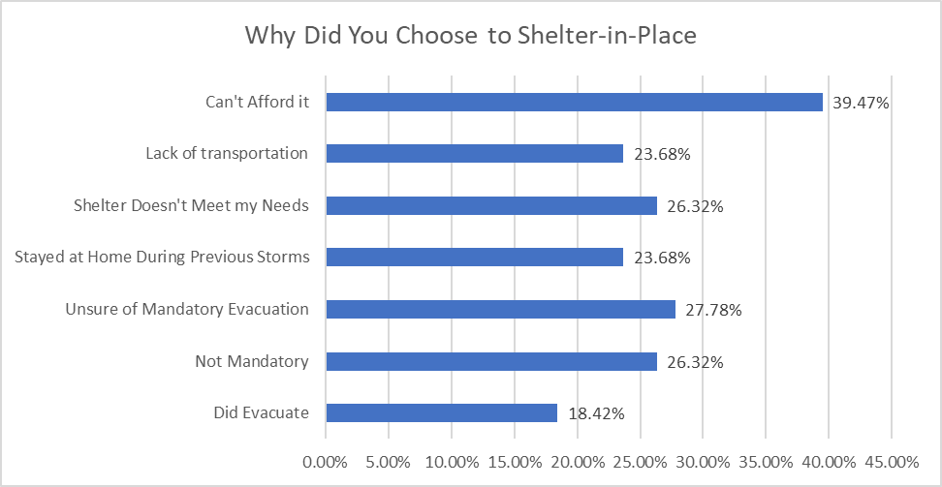
Why PWD Shelter in Place

Slide 26
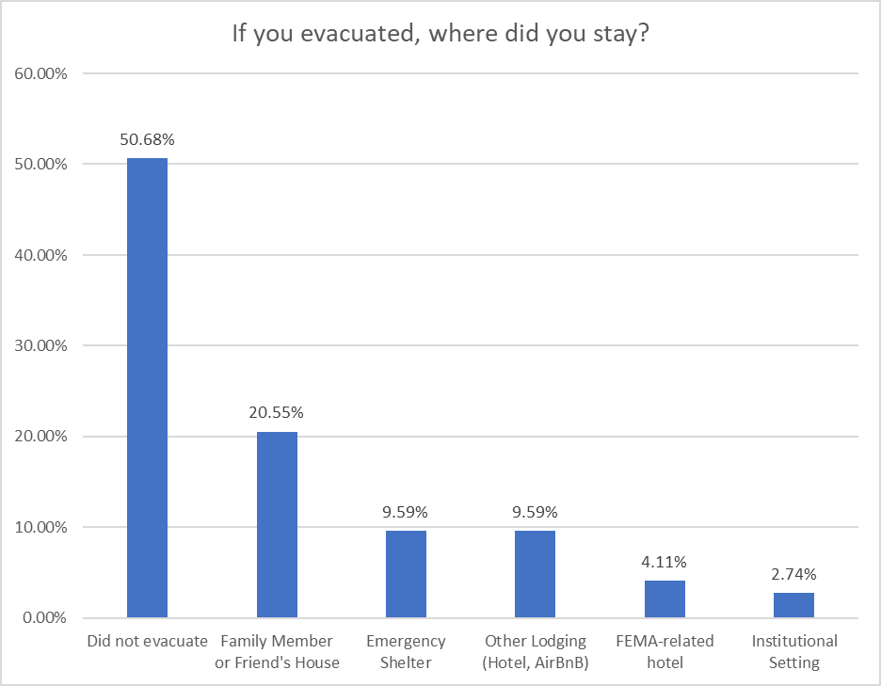
Where PWD Stay After Evacuating

Slide 27
How DRF and Orgs Can Help
Communicate disaster-related messaging to clients
Community Emergency Response Teams (CERT)
Annual emergency preparedness events for clients
Connect with local emergency management staff

Slide 28
Shelter and Transportation Resources in Florida
Shelters
  Special Needs Registry: SNR.FLHealthResponse.com
  General Population Shelters
  Special Needs Shelters
Transportation
  Advocacy
  Connections

Slide 29
Self-Advocacy & Planning

Slide 30
Self-Advocacy and Planning (1/2)
Plan WITH and not FOR
Disability partners must be included in shelter selection, opening and closing
Use of certified ASL interpreters at local, state and national press conferences
Continue the momentum of inclusion during and after a disaster

Slide 31
Self-Advocacy and Planning (2/2)
5) FEMA instructions and guidance in the IA process must be fully accessible and inclusive
6) Better collaboration with the deaf and blind communities before, during and after a disaster
7) Improve access to mental health services and post-disaster counseling long after the disaster
8) Honest discussions on the impact of climate change on disability community.

Slide 32
Disability Disaster Resources
The Partnership for Inclusive Disaster Strategies website
Disability Rights Florida website
Florida Division of Emergency Management website: FloridaDisaster.org
FEMA Individual Assistance
Disability and Climate Change: A Public Archive Project
National Oceanic and Atmospheric Administration NOAA Watch
National Weather Service All Hazards NOAA Weather Radio
Florida Department of Elder Affairs Disaster Preparedness
Florida State Courts Emergency Preparedness
Crisis Clean Up
Florida Feeding Sites … AND MORE

Slide 33
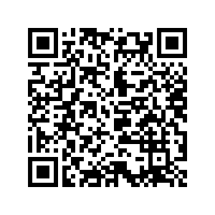
Attend Our Upcoming Webinar
How to Use Supported Decision Making in Florida
When
  August 14, 2024, from 11 am - 12 noon
Where
  Zoom
  Register online: bit.ly/3LmyD0g
Accessibility
  ASL interpreters
  CART English and translated captioning
Scan QR code with smartphone camera to register

Slide 34
Thank you & Survey
Follow Disability Rights Florida
Facebook: DisabilityRightsFlorida
Instagram: DisabilityRightsFL
LinkedIn: disability-rights-florida
YouTube: DisabilityRightsFL
Tiktok: DisabilityRightsFL
Twitter/X: DisabilityRtsFL
Follow The Partnership for Inclusive Disaster Strategies
Facebook: DisasterStrat
Instagram: DisasterStrat
LinkedIn: DisasterStrat
YouTube: DisasterStrat
Twitter/X: DisasterStrat
Please take our webinar survey. It will be open on your computer after you leave Zoom.

