Slide 1
How to Use Supported Decision-Making (SDM) in Florida
August 14, 2024
11 am - 12 noon
Presented by: Morgan Patipa, JD Advocate-Investigator
With guest speakers Karla and Yolanda Herrera

Slide 2
Accessibility

Slide 3
Caption Options & ASL
Closed Captions: CC button at the bottom of the screen
External Caption Viewer: Link provided in the chat.
ASL Interpreters: Spotlighted on your screen.

Slide 4
Submitting Questions & Recording
Q and A button: Located at the bottom of the screen
Email: Webinar@DisabilityRightsFlorida.org
You can submit questions at any time. We will answer them at the end.
This webinar will be recorded and posted on our website and YouTube channel.

Slide 5
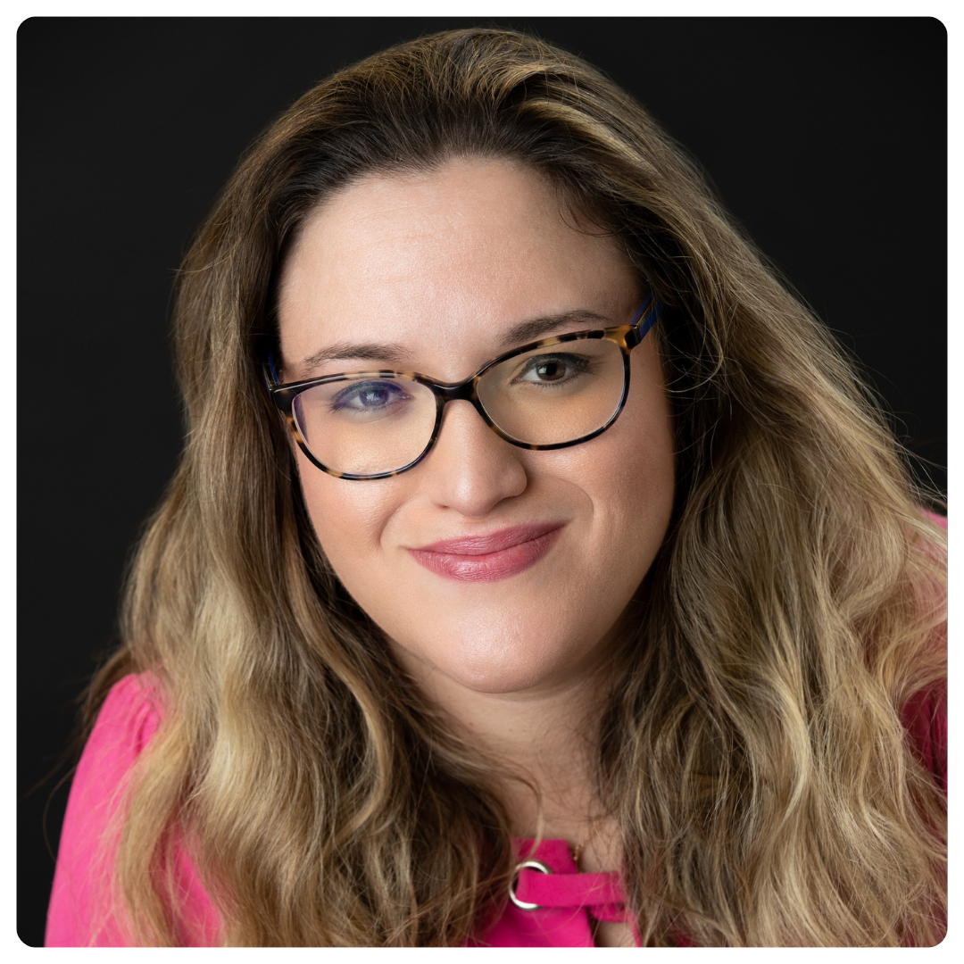
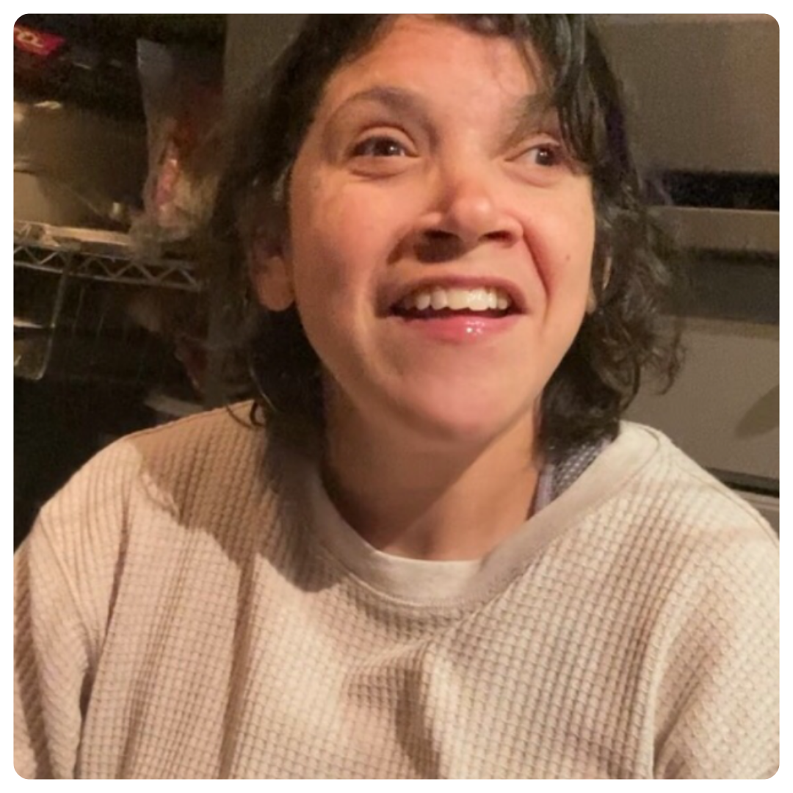
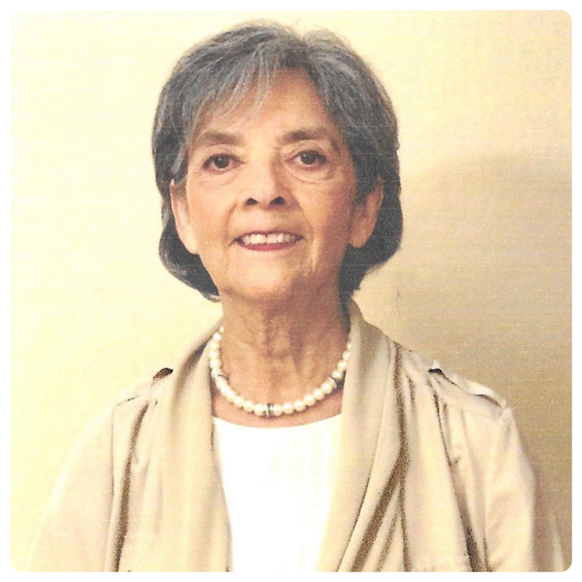
Introductions
Morgan Patipa, JD
Advocate-Investigator at Disability Rights Florida
Karla Herrera
SDM user, Apprentice Baker
Yolanda Herrera
Karla's Mom & Supporter, Disability Advocate

Slide 6
Agenda
What Supported Decision-Making is
Presuming competence
The dignity of risk
Why use Supported Decision-Making
How to use Supported Decision-Making
Overview of Florida’s SDM Law
Protections for Decision-makers
Conversation with Karla & Yolanda
Final Questions and Closing

Slide 7
What is Supported Decision-Making (SDM)?

Slide 8
About Disability Rights Florida (DRF)
Florida’s designated Protection and Advocacy System (P&A)
Our mission: To advocate, educate, investigate, and litigate to protect and advance the rights, dignity, equal opportunities, self-determination, and choices for all people with disabilities
Funding, responsibility, and authority under nine federal grants to protect the rights of Floridians with disabilities since 1977
DRF has access authority to any agency, institution, and organization that serves or houses people with disabilities. This is a power that other agencies do not have.

Slide 9
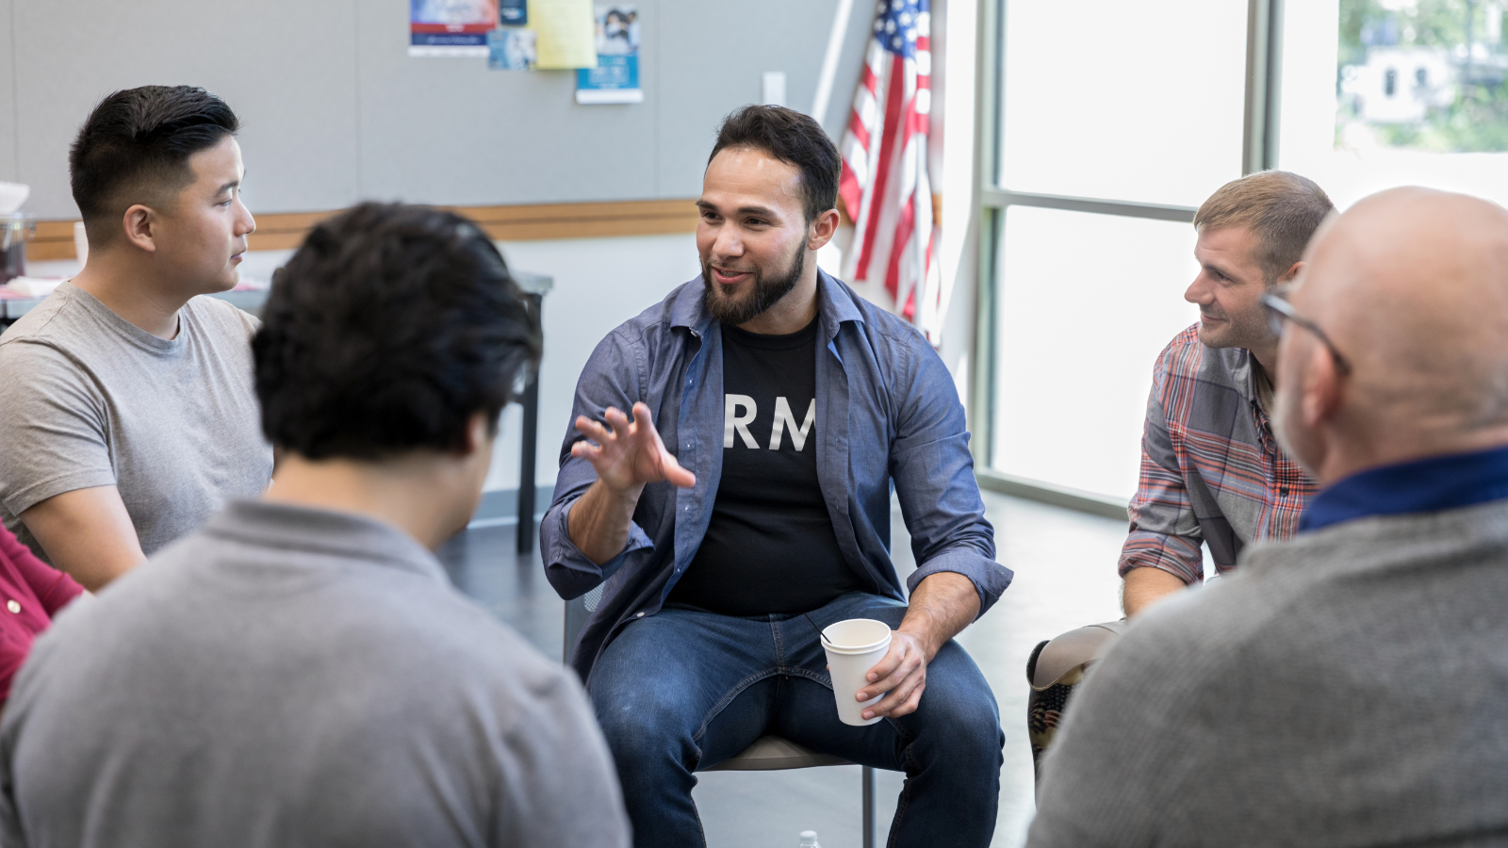
What is Supported Decision-Making (SDM)?
Legally recognized alternative to guardianship and guardian advocacy
Supported Decision-Making (SDM) is a collaborative process between the decision-maker and their supporters.
The decision-maker is the individual with the disability.
Their supporters are trusted people they can rely on to help the individual with a disability make decisions and understand the consequences of those decisions.

Slide 10
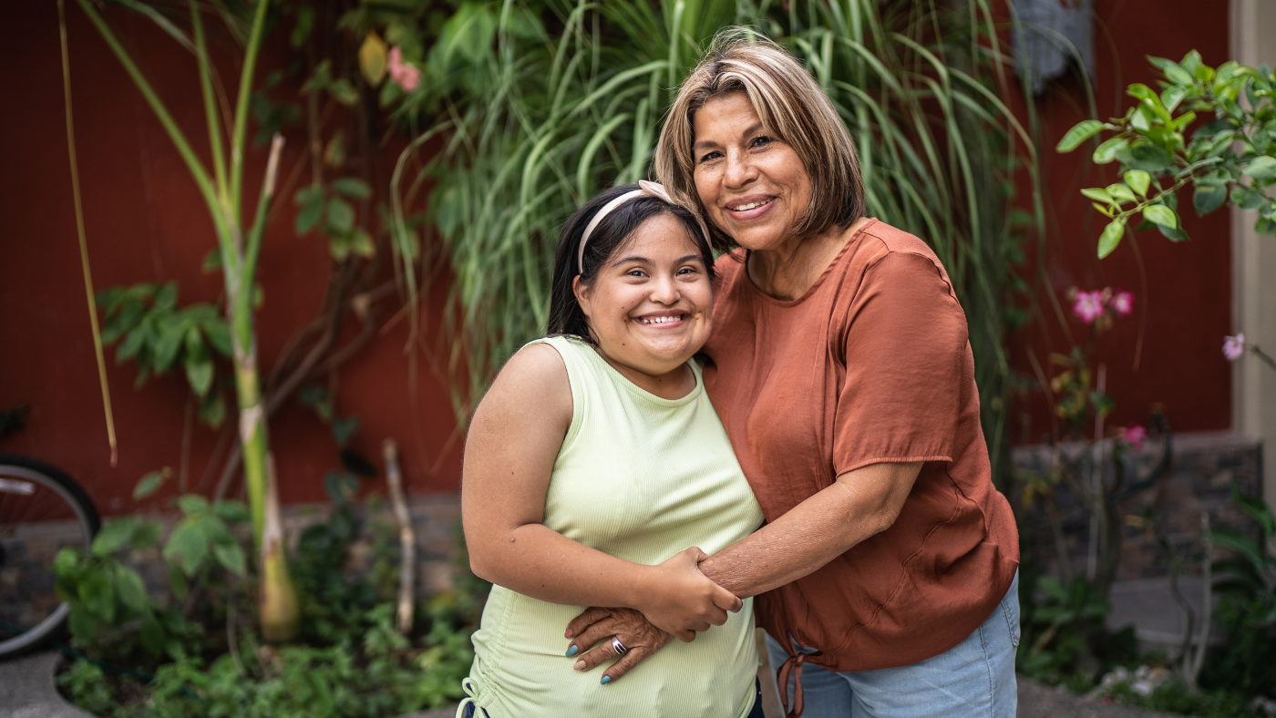
The Role of the Supporter
A supporter does not make decisions for the individual with a disability.
Instead, they are there to assist the decision-maker in making decisions. This can be in the form of:
Answering questions
Conveying the individual’s decision to another person
Understanding the meaning/significance of a decision

Slide 11
Presuming Competence
Legally, every person is presumed competent unless a Court deems that they are not.
Unfortunately, many people assume that all people with disabilities are unable to make their own decisions.
SDM is based on the principle that we “flip the script” of society and presume that individuals with disabilities are competent to make their own decisions.
There is no requirement that a person make only good decisions, just that they are able to make decisions.
Needing extra time or explanation does not mean a person cannot make their own decisions.
This allows us to understand that people with disabilities can make choices to the extent that they are able, even if it looks “different” than what you may have imagined.

Slide 12
Dignity of risk
Mistakes are part of the human experience.
Everyone makes mistakes, including people with disabilities.
Try as you might, you can’t bubble wrap your loved one with a disability.
Individuals with disabilities deserve to take risks and make mistakes, that’s how they grow, it’s how we all grow.
SDM preserves an individual with disability’s right to make mistakes and take risks.
It allows parents and caregivers the opportunity to watch their loved one with disability spread their wings and thrive.
While SDM is not for everyone, it can be a great alternative to guardianship.

Slide 13

Why use Supported Decision-Making?
It helps build and maintain independence.
It allows individuals with disabilities to grow as people and make their own choices.
It prevents abuse.
It allows individuals with disabilities to preserve their rights.
It increases confidence.
It increases education and employment opportunities and improves outcomes.

Slide 14
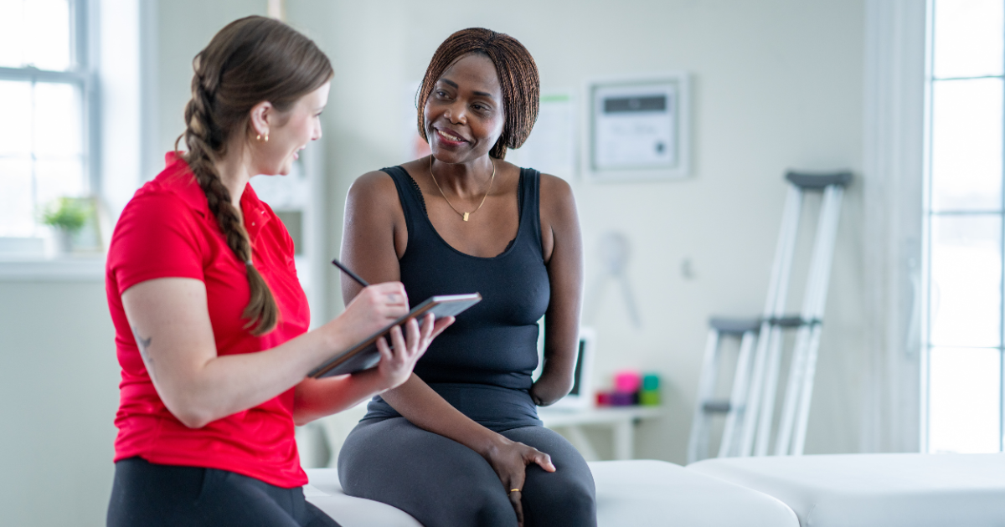
How to use SDM
SDM can be used as a written formal agreement or a more informal verbal agreement.
Supporters can meet with decision-makers as often as the decision-maker would like to discuss the decisions they need to make.
An SDM agreement can be used in combination with a health care proxy for medical decisions or even a power of attorney document.
SDM agreements look different for everyone.

Slide 15
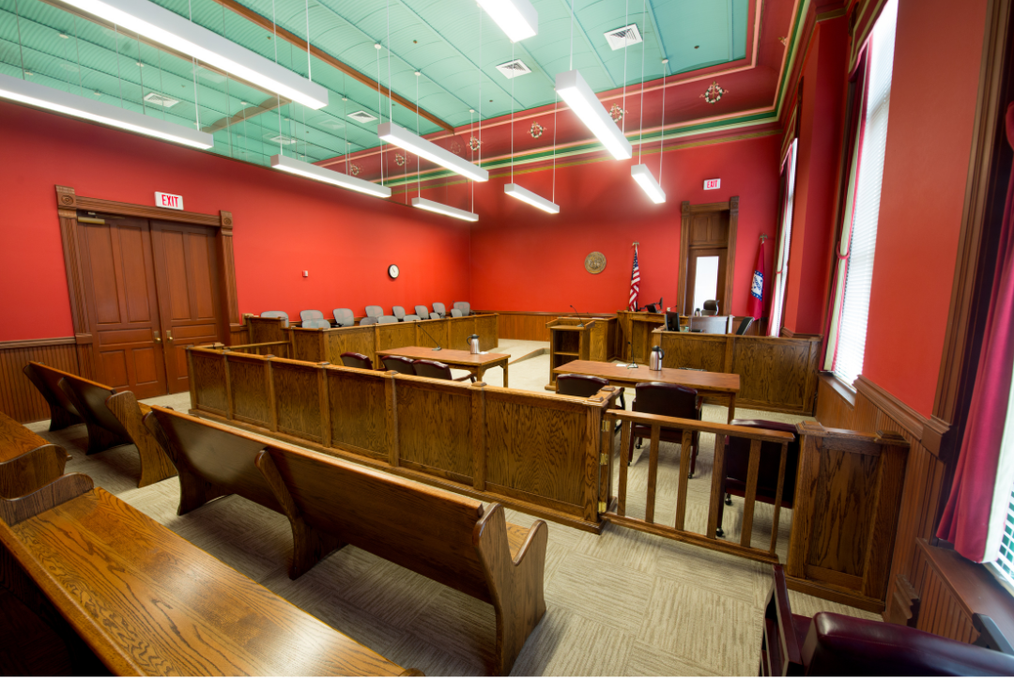
Florida’s SDM Law
Passed in 2024, supported by self-advocates
(§)709.2209, Fla. Stat.
Falls under the Power of Attorney (POA) statutes
Differs from standard POA

Slide 16

Key Features of Florida’s Law
Ensures Courts are aware of SDM
Notarization requirement
Can be revoked in writing at any time
Includes protections for the decision-maker

Slide 17
Protections for Decision-makers
825.103, Fla. Stat. – Exploitation of elderly or disabled person
709.2114, Fla. Stat.
The supporter is a fiduciary
Supporter cannot act against the decisionmaker’s best interest
Third parties must accept or reject the agreement within a reasonable time.
If someone refuses to accept the SDM agreement, they must tell you why in writing.

Slide 18
One Final Reminder
It is perfectly okay to ask for all the help you need to make decisions. We all ask for help at times.
It is important that each SDM agreement is uniquely tailored to the individual it is created for.

Slide 19
Karla and Yolanda's Experience with Supported Decision-Making

Slide 20
Questions?

Slide 21
Resources on DRF website
What is Supported Decision-Making?
Helpful Supported Decision Making Tools
SDM Success Stories
FAQs about Supported Decision-Making
Guardianship vs Guardianship Alternatives
What Are the Alternatives to Guardianship?
What Is Guardianship?
Types of Guardianship
Restoration of Rights
Concepts of Self

Slide 22
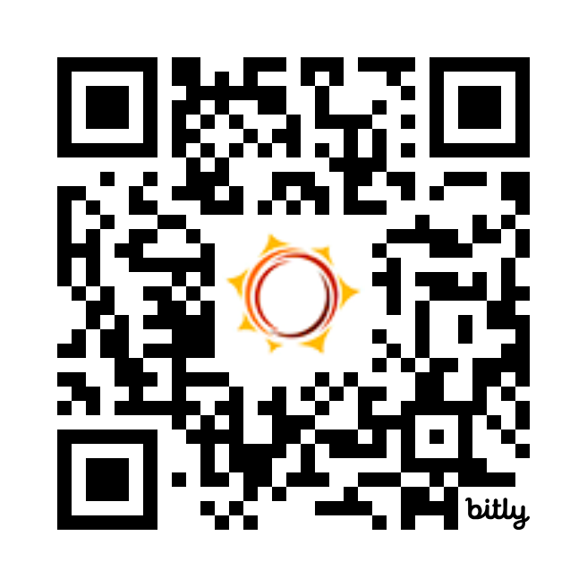
Thank You & Survey
Follow Disability Rights Florida on social media
Facebook: DisabilityRightsFlorida
Instagram: DisabilityRightsFL
LinkedIn: disability-rights-florida
YouTube: DisabilityRightsFL
Tiktok: DisabilityRightsFL
Twitter/X: DisabilityRtsFL
bit.ly/drf_training
Presentation Code: ZW4

