Slide 1
The Impact of Weight Stigma on Mental Health
By Shira Collings

Slide 2
Housekeeping
This presentation will be audio recorded. By joining you are giving consent to be audio recorded.
You can type a question in the chat box at any time during the presentation.
Questions will be taken at the end of the presentation.
Chat box questions will be answered at the end.
You will also be able to raise your hand and ask a question.

Slide 3
Introduction
Shira Collings is a graduate student in Clinical Mental Health Counseling at Troy University in Tampa, Florida. She is passionate about providing support to those struggling with disordered eating and body dissatisfaction and building a world that values size diversity. Her work is informed by the Health At Every Size paradigm, Fat Liberation, Body Trust, feminism, and the disability justice movement. She frequently presents on topics related to eating disorder treatment and prevention, as well as weight stigma and the Health At Every Size paradigm, at conferences for mental health professionals and peers. She currently serves as the Vice-Chair of the PAIMI Advisory Council to Disability Rights Florida, providing advice and support to a statewide organization on topics relating to mental health.

Slide 4
What is weight stigma?
Weight stigma is defined as bias, discrimination, or stereotyping that is based on a person’s weight or body size. It is a highly prevalent form of prejudice that is rarely challenged. Weight stigma is also referred to as weight bias, sizeism, fatphobia, and fatmisia.

Slide 5
A Note on Language
During this presentation, I will not be using the terms “overweight” or “obesity.” These terms are often stigmatizing and imply that being at a higher weight is inherently and universally unhealthy. I will use language recommended by the National Eating Disorders Association: people in larger bodies and higher weight people. In addition, some activists have chosen to reclaim the word “fat” as a neutral descriptor; this will also be included.

Slide 6
How does weight stigma show up?
Everyday assumptions about individuals’ character, self-discipline, eating/exercise habits, and health status on the basis of body weight alone
The idealization of thinness and pervasive promotion of weight loss in the media and healthcare settings
Hiring discrimination on the basis of weight; income disparities; workplace & school bullying; discrimination in adoption and custody
Denial of healthcare due to body weight

Slide 7
Prevalence of Weight Stigma
At least 30 percent of higher weight girls and 24 percent of higher weight boys report being teased at school
1 in 3 children has experienced weight bias from a teacher
69 percent of higher weight women have experienced weight bias from a physician
Higher weight women are paid 14.6 percent less than straight-sized women

Slide 8
Diet Culture
Weight stigma goes hand in hand with diet culture, i.e., the promotion of eating and exercising in pursuit of thinness rather than according to one’s internal cues and nutritional needs
Diet culture involves the oversimplistic categorization of food as “good” or “bad” and “healthy” or “unhealthy,” which often leads to shame around eating and compensatory behaviors
Dieting is a strong predictor of the development of eating disorders

Slide 9
Effects of Weight Stigma
Depression
Anxiety
Low self-esteem
Body dissatisfaction
Suicidal ideation & attempts
Disordered eating & eating disorders

Slide 10
Some Statistics
The best-known environmental contributor to the development of eating disorders is the sociocultural idealization of thinness.
40-60% of elementary school girls (ages 6-12) are concerned about their weight.
62.3% of teenage girls and 28.8% of teenage boys report trying to lose weight.

Slide 11
More Statistics
Over one-half of teenage girls and nearly one-third of teenage boys engage in disordered eating behaviors including skipping meals, fasting, smoking cigarettes for weight loss, vomiting, and taking laxatives.
13.2% of girls develop an eating disorder by age 20. Among adolescent males, the prevalence of eating disorders is 1.2% at 14 years, 2.6% at 17 years, and 2.9% at 20 years.
1 in 8 adults have had suicidal thoughts due to negative body image.

Slide 12
More Information on Eating Disorders
Eating disorders are the second deadliest mental health condition (surpassed only by opioid use disorder).
People with eating disorders of all sizes are at increased risk of a wide variety of physical and neurological health complications including heart failure, heart problems, kidney failure, GI problems, osteoporosis, insomnia, memory loss, and cognitive impairments.
Eating disorders often lead to increased depression and anxiety and can even induce paranoia and psychosis.
People with eating disorders face a high risk of suicide.

Slide 13
Weight Stigma & Marginalized Identities
Weight stigma disproportionately impacts people in minority groups, including people of color, LGBTQ people, disabled people, women, and trans people.
Weight stigma is rooted in racism and patriarchy and is used to justify these forms of oppression.
Disordered eating is under-recognized in minority groups. People of color and LGBTQ people are less likely to receive treatment.

Slide 14
The Social Determinants of Health
Social & economic factors (e.g., race, gender, income, disability, etc.) have a greater impact on health than individual behaviors. Promoting weight loss as a solution to mental and physical health problems may come at the cost of addressing social injustices/inequities underlying these issues.

Slide 15
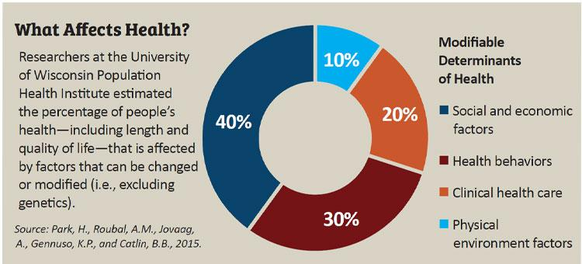
What Affects Health?

Slide 16

Video: Weight Stigma, Eating Disorders, & Body Liberation

Slide 17
Weight Stigma in Mental Health Services
Weight stigma is not commonly recognized as a contributor to mental health issues
Eating disorders under-recognized in individuals in larger bodies
Clients in larger bodies sometimes encouraged to diet/lose weight instead of receiving quality mental health care
Weight loss sometimes praised as a sign of health/psychological improvement without inquiry about possible disordered eating
Exercise commonly prescribed without discussion of over-exercise

Slide 18
Vicious Cycle
Clinicians fails to recognize eating disorders in “atypical” populations
Those individuals further alienated from seeking help
Clinical presentation of individuals with eating disorders stays homogenous (not diverse)
Existence of stereotypes, re: those affected by EDs
Source: Science of Eating Disorders; www.scienceofeds.org

Slide 19
One Person’s Story (1 of 5)
“When I was 16 I started starving myself and lost a lot of weight. I was never offered help. I wasn’t offered outpatient eating disorder therapy, or evaluated for a higher level of care.
It was 1998. I was a Christian teenager who came from a white, working-class family living in a middle-class suburb. I was straight and cis-passing. At the time, I did not have an understanding of eating disorders at all. In fact, even if someone had educated me on what eating disorders were, I don’t think I would have even thought that I was included in that definition. And that, in and of itself, is part of the problem. I had all the symptoms, but because I was fat, it seemed impossible that I could be struggling with something socially defined as a disorder that seemed to exclusively affect smaller people.

Slide 20
One Person’s Story (2 of 5)
In some ways, when I tell my story, I feel that I have to express the deep, intense pathologies that I experienced in order for people to believe me. I barely ate. I’d lie about having a meal, so no one would question me. I would flush food down the toilet to hide food and give the appearance that the food had been eaten. I’d track everything that I ate while making sure it was not above the ridiculously low calorie count that I set for myself. I exercised frequently. I could not stop thinking about food. I could feel my heart pounding in my abdomen when I laid in bed at night with an empty stomach. Despite all of this, I was still perceived as fat according to medical standards.

Slide 21
One Person’s Story (3 of 5)
After several months of this, I stopped being able to tolerate starving myself, and needed a way to cope with eating and my intense fear of weight gain. I started making myself throw up, using diet pills and laxatives to compensate for what I ate. Having to eat heightened my sense of feeling out of control and imposed a greater threat of gaining weight. I spent hours upon hours preoccupied with hiding what I was doing, and I would lie if needed.
My preoccupation with food and potential weight gain didn’t just have an impact on how I behaved around eating. My entire life was affected by the obsession that I couldn’t let go; that was egged on by everything around me. My grades plummeted. I was constantly exhausted. I couldn’t process information easily. I was ashamed of my dishonesty, and fearful someone would confront me about lying.

Slide 22
One Person’s Story (4 of 5)
I was almost the poster child for a Lifetime movie on teen girls with eating disorders. Except I was still fat. And looking back, I’m not sure that I was a girl. So I couldn’t possibly have had an eating disorder. Right?
Despite the fact that I remain fat throughout my eating disorder, I did experience weight loss. And when I lost weight from all of the starving and purging, I was complimented. Instead of being offered eating disorder treatment, which is what I desperately needed, I received copious amounts of praise everywhere I went for losing weight. And so I pressed on. I tried harder. I restricted more.

Slide 23
One Person’s Story (5 of 5)
Being congratulated is what happens when a larger-bodied person loses weight. It does not matter how they lost the weight. It could be from an eating disorder, grief, or even a serious illness like cancer. This is one of the many reasons why we should not ever comment on someone’s weight loss. We do not know the circumstances of why they lost weight. If it happens to be that they lost weight intentionally, we only encourage disordered eating and body dissatisfaction. And that is exactly what happened to me. . .and what happens to so many others like me.”
-Sarah J. Thompson, https://www.resilientfatgoddess.com/blog/whyeatingdisordertreatmentisfailingusall

Slide 24
Another Personal Story (1 of 2)
“I grew up with the message that to be loved in my family, I needed to be thin. Of course that message was confirmed further by our thin-obsessed culture and I spent the majority of my life fighting against my naturally larger body. During my periods of anorexia, I saw how much better I was treated in my smaller body and it made me even more determined to fight for my life and stand up to the fatphobia I saw happening to people in larger bodies.
In my smaller body, I was praised for my weight loss even though I was dying. No one made assumptions or judgements about my health, I was able to find clothes at any store I walked into, and living in my smaller body felt so much safer.

Slide 25
Another Personal Story (2 of 2)
But that safety and relief came at the cost of everything else in my life. As my body shrunk, so did my entire life. I couldn’t participate at holidays because I was afraid of being around food, I turned down travel opportunities because I was worried about not having access to the few foods I’d allow myself to eat, I completely isolated myself from all social events because starving and exercising came before anything else. My eating disorder took years away from me that I can never get back.”
-Shira Rosenbluth, LCSW, https://www.k-deer.com/blogs/news/meet-shira-rose

Slide 26
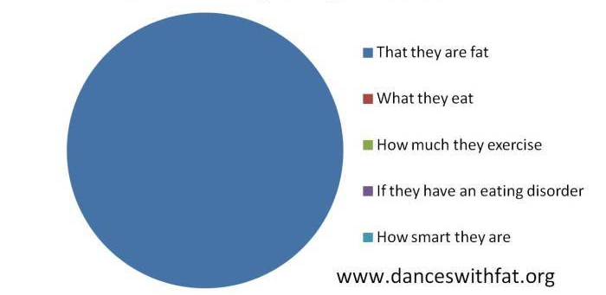
What You Can Tell By Looking at a Fat Person

Slide 27
Combating Weight Stigma: Start with Your Own Beliefs
Challenge any assumptions you have about people’s character, eating/exercise habits, and health status on the basis of size
Be willing to challenge any misconceptions you have about what people with eating disorders look like
Use terms like “people in larger bodies” or “higher weight people” rather than “overweight” or “obesity”
Focus on complimenting people’s character and internal strengths rather than weight loss

Slide 28
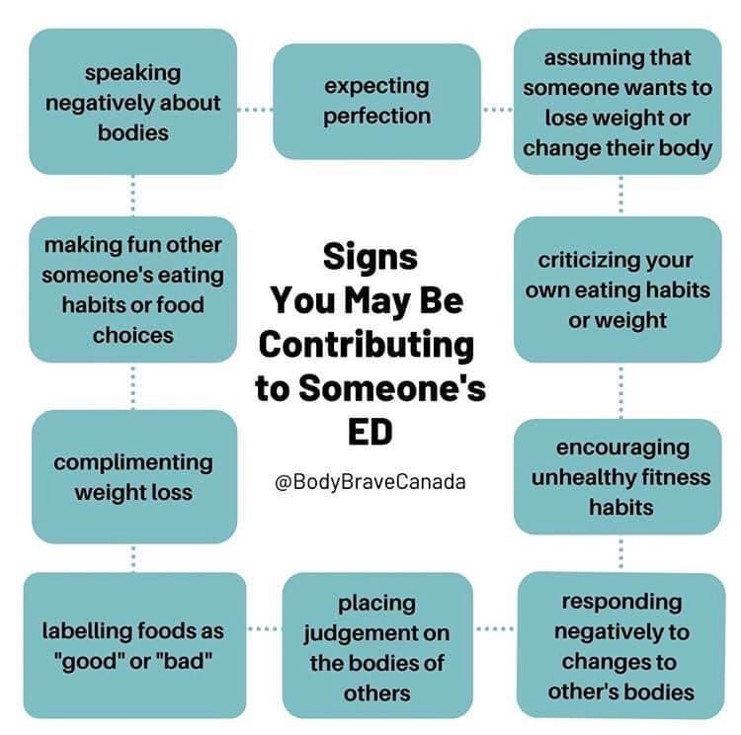
Signs You May Be Contributing to Someone’s ED

Slide 29
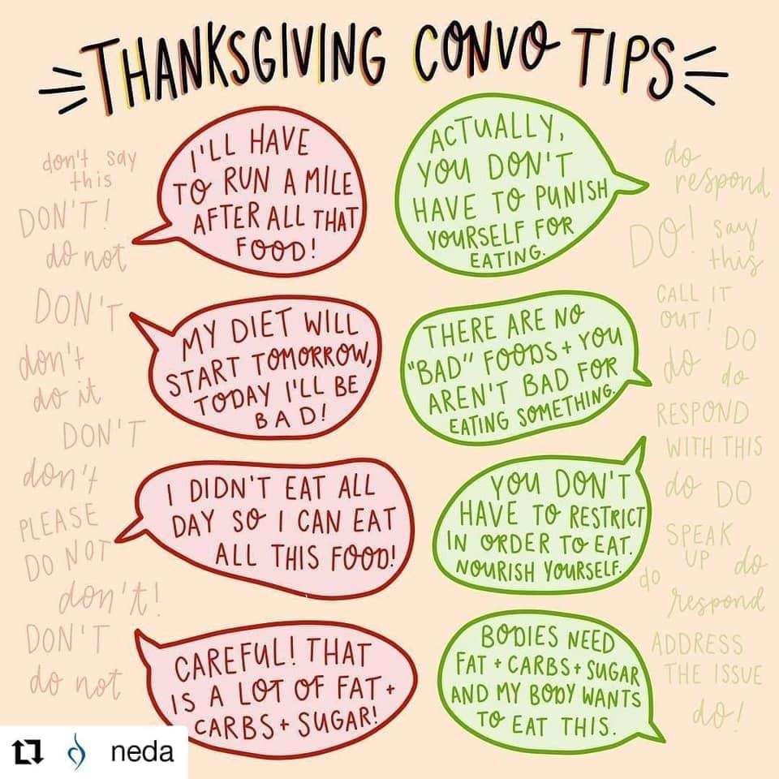
Thanksgiving Convo Tips

Slide 30
Combating Weight Stigma in Mental Health Care
Advocate for/provide weight inclusive care that acknowledges the impact of weight stigma on mental health
Make sure size diversity is included in diversity/inclusion initiatives
Advocate for mental health settings to be accessible to people in larger bodies (e.g., larger chairs, gowns in larger sizes, etc.)
Challenge the promotion of weight loss/dieting within mental health settings
Advocate for insurance coverage of eating disorder treatment for people of all body sizes

Slide 31
Challenging Cultural Weight Stigma
Speak out about the harmful effects of weight stigma
Follow and share the work of fat activists, healthcare professionals, and recovery advocates
Challenge misconceptions about weight stigma and eating disorders that you hear in your workplace/school/everyday life

Slide 32
References & Resources
Weight Stigma and Its Effects
https://www.nationaleatingdisorders.org/weight-stigma
Statistics
https://www.nationaleatingdisorders.org/statistics-research-eating-disorders
https://www.obesityaction.org/get-educated/public-resources/brochures-guides/understanding-obesity-stigma-brochure/
https://naafa.org/facts1
Combating Weight Stigma in Mental Health/Recovery Spaces
https://medium.com/@emily.cutler/the-need-for-size-equality-in-the-mental-health-recovery-movement-ways-that-peer-recovery-effb3d80beba

Slide 33
Further Reading/Learning (1 of 2)
Food Psych Podcast: https://christyharrison.com/foodpsych
Association for Size Diversity and Health: https://www.sizediversityandhealth.org/
National Eating Disorders Association: https://www.nationaleatingdisorders.org/

Slide 34
Further Reading/Learning (2 of 2)
Body Respect: What Conventional Health Books Get Wrong, Leave Out, and Just Plain Fail to Understand About Weight: https://lindobacon.com/body-respect-book/
The Body is Not An Apology: https://www.amazon.com/Body-Not-Apology-Radical-Self-Love/dp/1626569762
Anti-Diet: Reclaim Your Time, Money, Well-Being, and Happiness through Intuitive Eating: https://christyharrison.com/book-anti-diet-intuitive-eating-christy-harrison

Slide 35
Questions?
For those joining us in Zoom online, to ask your question:
Raise your hand.
Wait for us to call on you.
Click on “Unmute” when prompted.
For those joining us over the phone, to ask your question:
Press *9 to raise your hand.
Wait for us to call on you.
Press *6 to unmute yourself.

