Slide 1
Self Advocacy Series Part One: Motion to Continue
Caitlyn Clibbon
Director of Community and Healthcare Services
November 2024
Notes:
Hello and Welcome to Disability Rights Florida’s video series presenting self-advocacy resource materials or resource information for self advocates*?*

Slide 2
Accessibility

Slide 3
Caption Options & ASL
Closed Captions: CC button at the bottom of the screen
External Caption Viewer: Link provided in the chat
ASL Interpreters: Spotlighted on your screen

Slide 4
Submitting Questions & Recording
Q and A button: Located at the bottom of the screen
Email: Webinar@DisabilityRightsFlorida.org
You can submit questions at any time. We will answer them throughout the webinar.
This webinar will be recorded and posted on our website and YouTube channel.

Slide 5
About DRF & Agenda

Slide 6
Disability Rights Florida
Funding, responsibility, and authority under nine federal programs to protect the rights of Floridians with disabilities.
A not-for-profit corporation since 1987.
Offices in Tallahassee, Tampa, Gainesville and Fort Lauderdale.
Notes:
NOTE: removed reference to satellite offices – we don’t have those, right?

Slide 7
Our Mission
Disability Rights Florida advocates, educates, investigates, and litigates to protect and advance the rights, dignity, equal opportunities, self-determination, and choices for all people with disabilities.

Slide 8
Agenda
Words to Know
What is a Continuance?
Requesting a continuance through Office of Fair Hearings (OFH)
Requesting a continuance through Office of Appeal Hearings (OAH)
Notes:
This video will talk about how to request additional time or to reschedule a Medicaid or Medicaid Waiver Administrative Hearing. In this video we will be walking you through a request for continuance for the Office of Fair Hearings and Office of Appeal Hearings.
The Office of Fair Hearings (OFH) is part of the Agency for Health Care Administration. OFH employs hearing officers who conduct hearings in cases affecting fee-for-service and managed care recipients. In fee-for-service cases, OFH has jurisdiction when the Agency, or its agent, reduces, suspends, terminates, or denies a service. In managed care cases, OFH has jurisdiction when the Managed Care Plan reduces, suspends, terminates or denies a service and the recipient has exhausted the Plan’s appeal process. In both types of cases, failure by the Agency or the Plan to adhere to notice and timing requirements may also give rise to OFH’s jurisdiction.
The Office of Appeal Hearings (OAH) is part of the Florida Department of Children and Families’ Office of Inspector General. OAH employs full-time hearing officers who conduct hearings in cases where a state agency---such as the Agency for Persons with Disabilities (APD) or the Department of Children and Families (DCF)---makes a decision which unfavorably affects a person’s rights or benefits.

Slide 9
Words to Know
Petitioner: The person requesting an appeal, the person whose services are being reduced or denied.
Respondent: The Agency or organization that has reduced or denied petitioner’s services.
Hearing Officer: The presiding officer or “judge” at your hearing.
Conferral Statement: A “Conferral Statement” is your statement to the Hearing Officer that you contacted Respondent’s representative to get their input on your request for continuance.
Exp. I emailed Respondent’s representative, and they do not object to the Continuance.
Notes:
An exhibit is just an individual piece of evidence. That could be a picture. It could be a document. It could be a prescription. It could be any number of things. An exhibit is a single piece of evidence, and we will discuss preparing and gathering that evidence in just a couple of moments.
And finally, the hearing officer is, for lack of a better term, your judge. The hearing officer is an individual who works with the Office of Appeal hearings, which is a division within the Department of Children and Family Services who will adjudicate your appeal. It’s the individual who will help you with procedural issues, guide the process along, and ultimately make a determination on whether or not the agency’s decision should be upheld. And we’re going to discuss in the hearing section all of the things that the hearing officer can help you with.
Preponderance of the evidence is a legal standard meaning more likely than not – over 50% - Assigned to P in cases of denials or R in cases of reduction (explain this)

Slide 10
What is a continuance?
Continuance is what a hearing office may grant to delay proceedings until a later date.
Parties in a suit or the hearing officer may wish to have a continuance granted in order to prepare for a fair hearing.
Parties must read their hearing notices, which will outline any deadlines or timeframes in which continuances must be requested.
For Office of Fair Hearings (OFH), a request for continuance must be requested at least five days in advance of a scheduled hearing date, unless there are emergency circumstances that make that impossible.
For Office of Appeal Hearings (OAH), a continuance can be requested up until a scheduled hearing.

Slide 11
Which Hearing Office am I in?
The Office of Fair Hearings (OFH) is part of the Agency for Health Care Administration
OFH employs hearing officers who conduct hearings in cases affecting Medicaid fee-for-service and managed care recipients.
The Office of Appeal Hearings (OAH) is part of the Florida Department of Children and Families’ Office of Inspector General.
OAH employs full-time hearing officers who conduct hearings in cases where a state agency, such as the Agency for Persons with Disabilities (APD) or the Department of Children and Families (DCF), makes a decision which unfavorably affects a person’s rights or benefits.

Slide 12
Office of Fair Hearings Contact Information
OFH’s contact information for obtaining information from AHCA regarding a Medicaid Fair Hearing Request:
Agency for Healthcare Administration Office of Fair Hearings
2727 Mahan Drive, MS#11 Tallahassee, FL 32308
Telephone: (850) 412-3649
Fax: (850) 487-1423
Email: OfficeofFairHearings@ahca.myflorida.com
Website: https://flmedicaidmanagedcare.com/home/medicaidfairhearing

Slide 13
Office of Appeal Hearings Contact Information
Contact information for the Office of Appeal Hearings: Department of Children and Families, Office of Appeal Hearings
2415 North Monroe Street, Suite 400-I
Tallahassee, Florida 32303
Telephone: (850) 488-1429
Fax: (850) 487-0662
Email: appeal.hearings@myflfamilies.com
Website: https://www.myflfamilies.com/about-us/office-inspector-general/appeal-hearings/

Slide 14
Template One: Office of Fair Hearings
Notes:
timeline and mention opposing counsel, filing instructions, refer back to contact info from previous page, copy all parties

Slide 15
Template Two: Office of Appeal Hearings
Notes:
timeline and mention opposing counsel, refer back to contact info from previous page, copy all parties

Slide 16
Important to Note:
If you do not receive instruction from the Hearing Officer rescheduling your hearing, you must go to the hearing at the time and date it has been scheduled.
Failure to be present at a hearing can cause a dismissal of your case.

Slide 17
Questions? Please contact Disability Rights Florida at:
2473 Care Drive, Suite 200 Tallahassee, Florida 32308 800.342.0823 • TDD 800.346.4127 www.DisabilityRightsFlorida.org

Slide 18
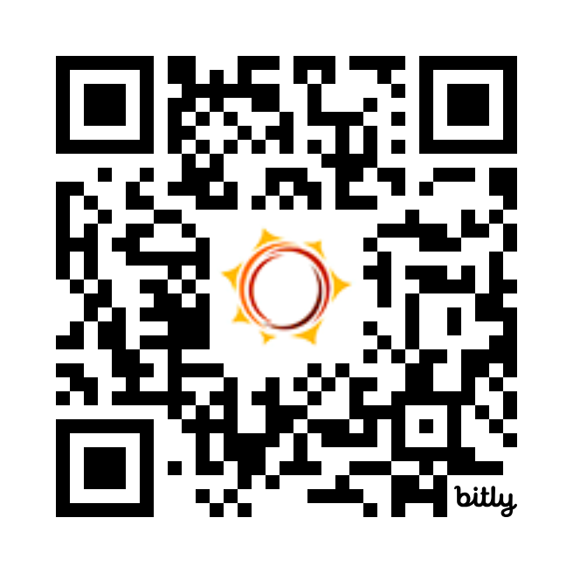
Feedback Survey
Tell us how we did!
Scan the QR code or visit
http://bit.ly/drf_training
to take our Presentation Feedback Survey
Use presentation code: ZW2

