Slide 1
Medicaid Long-Term Care Waiver Application Process and Waitlist
Caitlyn Clibbon, Director of Community and Healthcare Services

Slide 2
Accessibility

Slide 3
Caption Options & ASL
Closed Captions: CC button at the bottom of the screen
External Caption Viewer: Link provided in the chat
ASL Interpreters: Spotlighted on your screen

Slide 4
Submitting Questions & Recording
Q and A button: Located at the bottom of the screen
  Email: Webinar@DisabilityRightsFlorida.org
You can submit questions at any time. We will answer them throughout the webinar.
Please try to limit sharing your personal information in the chat or questions. You can reach out to our Agency if you have more specific questions related to your Fair Hearing.
This webinar will be recorded and posted on our website and YouTube channel.

Slide 5
About DRF & Learning Objectives

Slide 6
Disability Rights Florida
Funding, responsibility, and authority under nine federal programs to protect the rights of Floridians with disabilities.
A not-for-profit corporation since 1987.
Offices in Tallahassee, Tampa, Gainesville and Fort Lauderdale.

Slide 7
Our Mission
Disability Rights Florida advocates, educates, investigates, and litigates to protect and advance the rights, dignity, equal opportunities, self-determination, and choices for all people with disabilities.

Slide 8
Learning Objectives
Today, you will learn about:
  LTC Waiver Eligibility Requirements
  LTC Waiver Application/Screening Process
  LTC Waiver waitlist
  LTC Waiver Re-Screening Process
Note: We can’t advise on specific cases today. Please don’t put personal information into the chat. Please contact our intake department if you want to request individual assistance. Contact info will be provided at the end.

Slide 9
LTC Waiver Eligibility Criteria

Slide 10
Basic Eligibility Criteria
Basic Criteria
  65+ years old AND require nursing facility level of care; OR
  18+ years old AND eligible for Medicaid by reason of disability AND require nursing facility level of care; OR
  18+ years old AND have a diagnosis of cystic fibrosis AND require a hospital level of care.
  Regardless of category above, you must meet financial eligibility requirements for Medicaid (income and asset limits)

Slide 11
LTC Waiver Screening Process

Slide 12
Application/Screening for Eligibility
Financial eligibility decided by Department of Children and Families (DCF). Medical eligibility decided by Department of Elder Affairs (DOEA).
Medical screenings are completed by Aging and Disability Resource Centers (ADRC). Contact your local ADRC to request screening.
Find your local ADRC:
  1-800-963-5337 – Elder Helpline
  https://elderaffairs.org/resource-directory/aging-and-disability-resource-centers-adrcs/

Slide 13
Screening Process
Screening is done via telephone.
Takes about 1 hour.
Screening will result in a determination of your eligibility and priority score. This means you placement onto the waiver, onto the waitlist, or a denial of services.
You will receive a notification in writing of your screening results.
You may request a copy of the completed screening tool to verify its accuracy.

Slide 14
What are they screening for?
When screening for medical eligibility, the ADRC is looking for information on:
  Mental health/behavior/cognition
  Physical health
  Activities of daily living
  Instrumental activities of daily living
  Nutrition status
  Health conditions/special services/medications
  Caregiver status
  Social resources
  Environmental risks

Slide 15
LTC Waiver Waitlist

Slide 16
Waitlist Priority Scores
Low Priority Score: Rank 1-2
High Priority Score: Rank 3-8
Those with low priority scores are not placed on the waitlist.
The higher your priority score, the closer you are to the top of the waitlist.
Some individuals can bypass the waitlist.

Slide 17
Who can bypass the waitlist?
Ages 18-20, with a chronic debilitating disease or condition that makes the individual dependent on 24/7 medical, nursing, or health supervision or intervention.
Nursing facility residents who request to transition to the community if they have lived in a Florida-licensed skilled nursing facility for at least 60 consecutive days.
Individuals referred by DCF Adult Protective Services who is identified as high-risk and who is placed in an assisted living facility by DCF.
Adults with Cystic Fibrosis

Slide 18
LTC Waiver Rescreening

Slide 19
Who can be re-screened?
Low Priority Score: Rank 1-2
  You MAY be re-screened annually.
  You WILL be re-screened if you notify the ADRC of a significant change in circumstances.
High Priority Score: Rank 3-8
  You WILL be re-screened annually.
  You WILL be re-screened if you notify the ADRC of a significant change in circumstances.

Slide 20
What is a significant change in circumstances?
Significant change means:
  An individual’s health status after an accident or illness, or
  An actual or anticipated change in the individual’s living situation, or
  A change in the caregiver relationship, or
  Loss or damage to the individual’s home or deterioration of their home environment, or
  Loss of the individual’s spouse or caregiver.

Slide 21
LTC Waiver – What happens when you are approved for services?

Slide 22
What happens after approval?
If you bypass the waitlist or if you are otherwise approved for services, you will be enrolled onto the LTC Waiver.
You will be sent a notice from DOEA. You must complete and return the form within 30 days of the date on the notice.
The Agency for Healthcare Administration is responsible for enrolling you on the waiver.
You will initially be assigned to a Managed Care plan. You will be notified of the plan chosen for you as well as the process to select a different managed care plan if you choose. There will be a deadline to change plans in your notice.
After initial enrollment, you may change plans in the first 120 days you are on the waiver. After that, you may only change plans during open enrollment or if you prove good cause.

Slide 23
LTC Waiver – Challenges to Agency Decisions

Slide 24
Challenges to Agency Decisions
If you disagree with your screening results or with the level of care determination made when you are offered services, you may request a fair hearing.
Your notice should contain directions on how to request the fair hearing.
*Note: Please refer to DRF’s website to learn more about how to prepare and present your Medicaid fair hearing: https://disabilityrightsflorida.org/resources/webinars_and_trainings

Slide 25
Questions?
Please contact Disability Rights Florida at:
2473 Care Drive, Suite 200
Tallahassee, Florida 32308
800.342.0823 • TDD 800.346.4127
www.DisabilityRightsFlorida.org

Slide 26
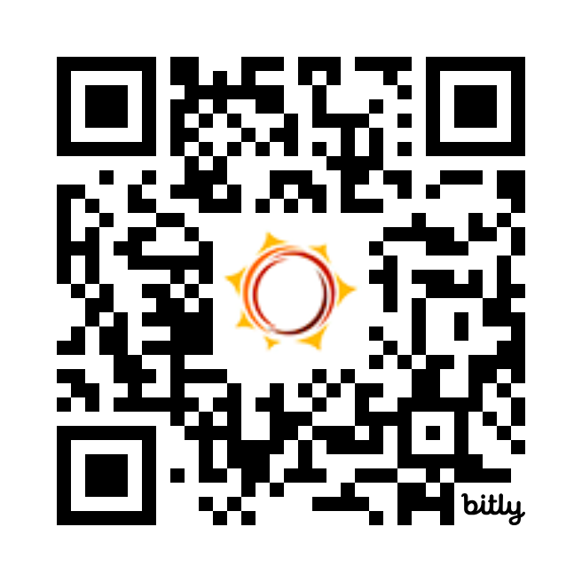
Feedback Survey
Tell us how we did!
Scan the QR code or visit
http://bit.ly/drf_training
to take our Presentation Feedback Survey
Use presentation code: ZW5

