Slide 1
Reasonable Accommodations in the Workplace
Presented by:
Allison Klein
Senior Advocate Investigator
Client Assistance Program (CAP) Coordinator

Slide 2
Accessibility

Slide 3
Caption Options & ASL
Closed Captions: CC button at the bottom of the screen
External Caption Viewer: Link provided in the chat
ASL Interpreters: Spotlighted on your screen

Slide 4
Submitting Questions & Recording
Q and A button: Located at the bottom of the screen
Email: Webinar@DisabilityRightsFlorida.org
You can submit questions at any time. We will answer them throughout the webinar.
Please try to limit sharing your personal information in the chat or questions. You can reach out to our Agency if you have more specific questions related to your Fair Hearing.
This webinar will be recorded and posted on our website and YouTube channel.

Slide 5
About DRF & Learning Objectives

Slide 6
Disability Rights Florida
Funding, responsibility, and authority under nine federal programs to protect the rights of Floridians with disabilities.
A not-for-profit corporation since 1987.
Offices in Tallahassee, Tampa, Gainesville and Fort Lauderdale.

Slide 7
Our Mission
Disability Rights Florida advocates, educates, investigates, and litigates to protect and advance the rights, dignity, equal opportunities, self-determination, and choices for all people with disabilities.

Slide 8
Learning Objectives
Today, you will learn about:
What are Reasonable Accommodations
How to make requests for Reasonable Accommodations
How to work within the Interactive Process
Note: We can’t advise on specific cases today. Please don’t put personal information into the chat. Please contact our intake department if you want to request individual assistance. Contact info will be provided at the end.

Slide 9

Employment Accommodations

Slide 10
What are Reasonable Accommodations?
Reasonable accommodations are adjustments or modifications that enable people with disabilities to perform the essential functions of a job efficiently and productively.

Slide 11
Reasonable Accommodations
Accommodations vary depending upon the nature of the job and the needs of the individual applicant or employee.
Notes:
Not all people with disabilities (or even all people with the same disability) will require the same accommodation or any accommodation. Furthermore, research by the Job Accommodation Network (JAN) indicates that more than half of accommodations cost nothing at all.

Slide 12
Examples of Reasonable Accommodations
Reasonable accommodations may include, but are not limited to:
Job restructuring
Modifying work schedules
Acquiring or modifying equipment or devices
Adjusting or modifying tests and training materials
Reassigning to a vacant position
Providing Assistive Technology or devices
Notes:
Job restructuring: such as altering when and/or how an essential function of a job is performed or reallocating marginal job functions that an employee is unable to perform because of a disability. Modifying work schedules can allow an employee with a disability to attend to matters related to treating the disability, such as medical appointments or medication schedules. Acquiring or modifying equipment or devices such as adjusting a desk height to accommodate an employee who uses a wheelchair or providing an employee with quadriplegia a mouth stick device to type on their computer.’
Adjusting or modifying tests and training materials (for example, providing materials in alternate formats, such as braille, CD or large print). Reassigning an employee with a disability to a vacant position for which he or she is qualified when no longer able to perform the essential functions of the current job with or without reasonable accommodations.
Providing assistive technology or devices such as computer screen readers for employees with visual impairments or a specific telephone that is compatible with an employee’s hearing aid (this does not include personal assistive devices such as hearing aids or prosthetics).

Slide 13
Making Reasonable Accommodations
Providing Accommodations
Selecting an Accommodation
Notes:
Providing Accommodations: An employer generally does not have to provide a reasonable accommodation unless an individual with a disability has asked for one. Once a request is made, the employer must engage in an interactive process.
• Selecting an Accommodation: Where more than one accommodation would work, an employer may choose the one that is less costly or that is easier to provide

Slide 14
Undue Hardship
Undue Hardship: An employer is required to make a reasonable accommodation to the known disability of a qualified applicant or employee as long as it does not impose an “undue hardship” on the operation of the employer’s business.
Notes:
An accommodation may impose an undue hardship if it requires significant difficulty or expense when considered in light of factors such as an employer’s size, financial resources (including the resources of the parent company) and the nature and structure of its operation.

Slide 15
Essential Job Functions
An employer is not required to lower quality or production standards to make an accommodation. Employees are expected to perform the essential functions of the job with or without reasonable accommodations.

Slide 16
Cost of Accommodations
The cost of providing an accommodation is often misunderstood and misrepresented. Various studies have found that reasonable accommodations cost much less than many employers expect.

Slide 17
Receiving Requests for Accommodations (1 of 2)
An applicant or employee may request a reasonable accommodation at any time during the employment cycle if they have a disability and cannot fully participate in the application process or perform the essential function(s) of the job.
Notes:
A request for a workplace adjustment qualifies as a request for reasonable accommodation if the change is requested for a reason related to his/her disability

Slide 18
Receiving Requests for Accommodations (2 of 2)
To request an accommodation, employees:
• Do not need to use medical terminology or explain their disability/condition (they may use “plain English”).
• May ask for a workplace adjustment without specifically referring to the Americans with Disabilities Act (ADA) or using the words “accommodation” or “reasonable accommodation.”
• Should specify that the request is related to a disability.
• May ask a third party to request the accommodation on their behalf (medical professional, vocational rehabilitation counselor, job coach, etc.).

Slide 19
Interactive Process (1 of 6)
Following an accommodation request, the employer and the individual should engage in the interactive process to identify the appropriate reasonable accommodation.
Notes:
The Americans with Disabilities Act (ADA) requires covered employers to provide effective, reasonable accommodations for employees with disabilities. To help determine effective accommodations, the Equal Employment Opportunity Commission (EEOC), recommends that employers use an “interactive process,” which simply means that employers and employees with disabilities who request accommodations work together to come up with accommodations.

Slide 20
Interactive Process (2 of 6)
According to the EEOC, the interactive process is not always required under the ADA.
Notes:
In many instances, the appropriate accommodation is obvious and therefore it is not necessary to go through a step-by-step process. For example, if an employee who uses a wheelchair requests that his desk be placed on blocks to elevate the desktop above the arms of the wheelchair and the employer complies, an appropriate accommodation has been requested, identified, and provided without the need for a formal process.

Slide 21
Interactive Process (3 of 6)
When an accommodation is not obvious, an appropriate accommodation is best determined through a flexible, interactive process.
Notes:
As part of this process, the EEOC recommends that employers:
(1) Analyze the particular job involved and determine its purpose and essential functions;
(2) Consult with the individual with a disability to ascertain the precise job-related limitations imposed by the individual's disability and how those limitations could be overcome with a reasonable accommodation;
(3) In consultation with the individual to be accommodated, identify potential accommodations and assess the effectiveness each would have in enabling the individual to perform the essential functions of the position; and
(4) Consider the preference of the individual to be accommodated and select and implement the accommodation that is most appropriate for both the employee and the employer.

Slide 22
Interactive Process (4 of 6)
If a manager or direct supervisor receives an accommodation request, he or she should refer the employee to HR or another person who is responsible for responding to such requests.
Notes:
The person receiving the accommodations request may:
Ask questions that will enable him/her to make an informed decision about how to meet the request. Including:
What type of accommodation is the employee requesting?
What is the nature of the employee’s disability/functional limitation?

Slide 23
Interactive Process (5 of 6)
Request documentation of the disability from an appropriate professional.
Do further research on the ADA or reasonable accommodations.
Determine whether the employee’s condition is covered under the ADA.
Contact JAN for guidance on the types of accommodations that might best meet the needs of the employee and organization.
Refer the employee to the appropriate person within the organization, if there is a designated individual who handles accommodations requests, and then follow up with both to ensure the request is adequately addressed.

Slide 24
Implementing Reasonable Accommodations
There are no specific policies or procedures that employers must follow when trying to accommodate an employee with a disability, but requests must be made within a reasonable time. It is also advisable to communicate with employees regarding progress made in providing the accommodation especially if it may take some time.
Notes:
The accommodations process is most effective when:
It is focused on essential job tasks and the physical or cognitive functions necessary to complete them, not on the employee’s disability.
Employees are asked to suggest the type of accommodations that may be most effective to ensure their productivity.
Employers customize positions to capitalize on the strengths and creativity of the employee.

Slide 25
Formal Accommodations Process
Some employers opt to establish formal accommodations policies and procedures and to centralize this function. Some of the benefits of having a formal policy include:
Increased likelihood that accommodation requests will be handled properly and consistently.
Improved documentation of an employer’s efforts to comply with the ADA.
Improved understanding among employees about what to expect if they request an accommodation.

Slide 26
Duplication of Documentation
An employee who already provided documentation of their disability should not have to provide new medical records for the same disability.

Slide 27
How Can Disability Rights Florida Help You?

Slide 28

Top Three Reasons To Contact Us
Free & confidential
Wide range of priorities
Various services

Slide 29
Services To Individuals
Most of our callers receive valuable short-term services such as:
Information and referral
Short-term assistance
Self-advocacy support
Technical assistance
Others receive services such as:
Investigations
Dispute resolution support
Negotiation and mediation support
Advocacy services
Legal representation

Slide 30
Funding Disclaimer
This presentation was produced at U.S. taxpayer expense through a grant from the Social Security Administration. While Social Security reviewed this communication for technical accuracy, it is not an official Social Security communication.

Slide 31
Questions? Please contact Disability Rights Florida at:
2473 Care Drive, Suite 200 Tallahassee, Florida 32308 800.342.0823 • TDD 800.346.4127 www.DisabilityRightsFlorida.org

Slide 32
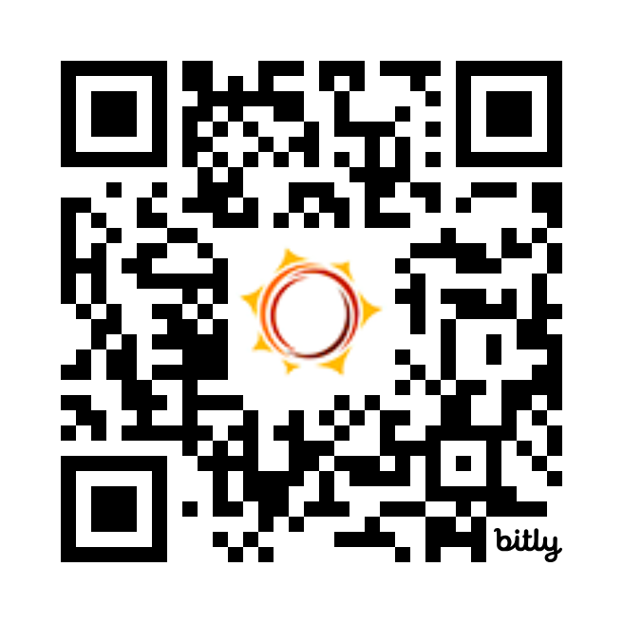
Feedback Survey
Tell us how we did!
Scan the QR code or visit
http://bit.ly/drf_training
to take our Presentation Feedback Survey
Use presentation code: ZM6

