Slide 1
Service Animals: Your Independence Your Access Your Rights
Presented by:
-Marion Gwizdala
-Barb Page

Slide 2
Accessibility

Slide 3
Caption Options & ASL
Closed Captions: CC button at the bottom of the screen
External Caption Viewer: Link provided in the chat
ASL Interpreters: Spotlighted on your screen

Slide 4
Submitting Questions & Recording
Q and A button: Located at the bottom of the screen
Email: Webinar@DisabilityRightsFlorida.org
You can submit questions at any time. We will answer them throughout the webinar.
Please try to limit sharing your personal information in the chat or questions. You can reach out to our Agency if you have more specific questions relating to service animals.
This webinar will be recorded and posted on our website and YouTube channel.

Slide 5
Disability Rights Florida Barb Page
Protection and Advocacy (P&A) to protect the rights of people with disabilities
Federally funded through 9 separate grants
Serve all Floridians with disabilities
Mission statement: “Disability Rights Florida advocates, educates, investigates, and litigates to protect and advance the rights, dignity, equal opportunities, self-determination, and choices for all people with disabilities.”
Notes:
My name is Barb Page..I am a white woman with gray/white hair wearing lightblue eyeglasses and have on a ____ colored shirt.
I have been a disability rights advocate for nearly 35+ years, 24 of which has been with DRF. I am very excited today to share this time with Marion Gwizdala as we discuss Service Animals.

Slide 6
Advocates for Service Animal Partners Marion Gwizdala
Dedicated exclusively to supporting, enhancing, and protecting rights of individuals with service animals
Nationwide network of volunteer service animal advocates
Encourage, educate, and support service animal handlers
Provide education regarding service animals to employers, governmental entities, private companies, housing accommodations, and airline industry

Slide 7
Learning Objectives
Today, you will learn about:
Definition of a Service Animal
How to determine whether it is a service animal or not
Explanation of the various laws which protect the mutual rights and responsibilities. (handlers and business owners)
Where to go for help if you face discrimination
NOTE: We can’t advise on specific cases today. Please don’t put personal information into the chat. Please contact our intake department if you want to request individual assistance. Contact info will be provided at the end.

Slide 8
Poll question #1
Under the Americans with Disabilities Act (ADA), a service animal can only be a dog?
True or false?

Slide 9
What is a Service Animal?
Must be a dog (Some circumstances may be a miniature horse)
Must be individually trained to do work or perform specific tasks related to the person’s disability
There are no restrictions on breed of dog, or type of disability
Must be under control of the handler at all times
Dogs that solely provide sense of security, emotional support, or
companionship are not a service animal
Does not need to be registered or have certification documents
A service animal is not required to wear a vest or specific identifying gear
Notes:
Mini horse- Can the facility accommodate the miniature horse? Handler must have control. Horse must be housebroken.
No restrictions on breed of dog.
No restrictions on types of disabilities that can utilize a service dog.

Slide 10

What can you ask/not ask?
When not obvious what a service animal provides, limited questions are allowed:
(1) is the dog a service animal required because of a disability?
(2) what work or task has the dog been trained to perform?
Questions not allowed:
Proof of training or certification
Nature of the Disability
Demonstration of the dog’s task
Proof of vaccinations

Slide 11
Handler Responsibilities- Service animals….
Must be under control of its handler.
Doesn’t bark or growl unprovoked
Doesn’t approach others or is otherwise disruptive
Must be housebroken
Must be harnessed, leashed, or tethered
exception: unless the individual’s disability prevents using these devices or these devices interfere with the service animal’s safe, effective performance of tasks
Must not be placed in grocery carts, seated on vehicle or table seats, or be fed from restaurant table

Slide 12
Poll Question #2
If a service animal is out of control, can a business owner require the individual to leave the premises?
Yes or no?

Slide 13
Business Owners- Your role; Your Rights:
Must allow individual to bring their service animal into your business
May ask the two allowable questions if it is not apparent what the service is provided
If the service animal is disruptive, you may ask for the service animal to be removed, but not the individual
You are not responsible for providing care or food for the service animal
Allergies and fear of dogs are not valid reasons for denying a service animal entrance
Notes:
If you are a business owner, you may ask for the service animal to be removed if it is behaving badly and the handler isn’t able to get the animal under control.

Slide 14
Protection Rights and Laws
Americans with Disabilities Act (ADA)
Fair Housing Act (FHA)
Air Carrier Access Act (ACAA)
Florida Statute 413.08
Notes:
Federal law supersedes state and local laws
States can make laws granting broader rights (more than) but cannot make laws more restrictive (less than).
413.08(includes service animals in training and criminal remedies)

Slide 15
Americans with Disabilities Act (ADA)
Title I - Employment
enforced by the Equal Employment Opportunity Commission (EEOC)
Title II - Public Services: State and Local Government
enforced by the Department of Justice (DOJ)
Title III - Places of Public Accommodations
enforced by the Department of Justice (DOJ)
Title IV – Telecommunications
enforced by the Federal Communications Commission (FCC)
Title V -Miscellaneous
Notes:
I-Helps people with disabilities access the same employment opportunities.
Applies to employers with 15 or more employees. Requires employers to provide reasonable accommodations to qualified applicants or employees
II Prohibits discrimination on the basis of disability by “public entities” such as state and local government agencies. Must make programs, services and activities accessible to individuals with disabilities.
III Prohibits public places from discriminating against PWD. Public accommodations include privately owned, leased or operated facilities like hotels, restaurants, stores. Sets the minimum standards for accessibility for alterations and new construction of commercial facilities and privately owned public accommodations. It also requires public accommodations to remove barriers in existing buildings where it is easy to do so without much difficulty or expense. Directs businesses to make "reasonable modifications" to their usual ways of doing things when serving people with disabilities.
IV Requires telephone and Internet companies to provide a nationwide system of interstate and intrastate telecommunications relay services that allows individuals with hearing or speech disabilities to communicate over the telephone. Requires closed captioning of federally funded public service announcements.

Slide 16
ADA and Service Animals
Title I – An employee with a service animal must request a reasonable accommodation from the employer prior to bringing the service animal to work.
Title II and III – Most facilities (either a government building or place of public accommodation) must allow a service animal into the facility with the individual.
Exceptions:
Religious Organizations & Private Clubs
Sterile environments such as surgery room or food prep area
Title IV –
Title V- Retaliation and right to refuse

Slide 17
Florida Statute 413.08
Establishes rights for equal access for those who use of service animals to:
Places of public accommodations
Employment
Housing
Outlines penalties for violations:
Statute provides for penalties against those who discriminate or interfere with a service animal.
Interference: examples of imposed penalties include obstructing, intimidating, jeopardizing the safety of, or intentionally injuring or killing the service animal.

Slide 18
Poll Question #3
Do shelters allow service animals?
Yes or no?

Slide 19
Can my service animal go there?
Yes, you can go here!
Shelters
Stores
Hospitals
Theaters
Medical offices
On a plane
In a cab
No, you cannot go here!
Food prep areas
Restaurant kitchens
Sterile environments
Operating rooms
Isolation rooms
ICU with equipment for life support (case by case)
Some pre-op settings
Notes:
Yes Marion speak about Shelter access.

Slide 20
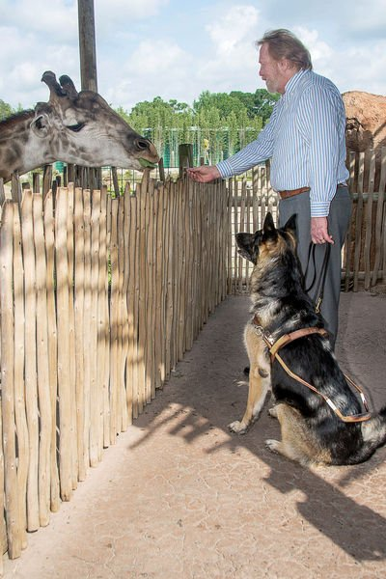
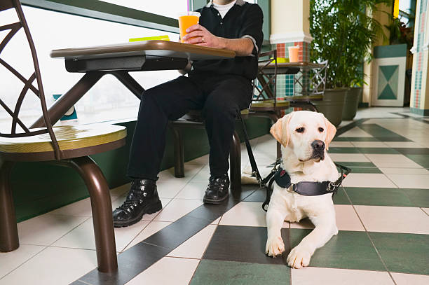
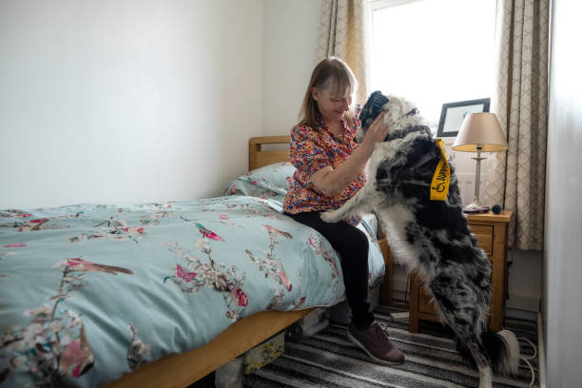

Oh! The places we will go!
Notes:
Marion and service dog Sarge feeding a giraffe.
Picture of a service dog in a café on the floor near handler’s seat.
Young woman in dorm room with her service animal
Young girl in the library reading a book to her service dog!

Slide 21
Fair Housing Act (FHA)
Fair Housing Act uses language of “assistance animal”
Assistance animal works, provides assistance, performs tasks for the benefit of a person with a disability, or provides emotional support that alleviates one or more identified effects of a person’s disability.
Is NOT a pet.
May be an animal other than dog (cat, bird, rabbit)
May require documentation
Examples of reasonable accommodation requests:
Request for an assistance animal in housing that has “no-pets” policy
Request to waive a pet deposit or fee

Slide 22
Air Carrier Access Act (ACAA)
Specific regulations for air travel –
Prohibits discrimination against individuals with disabilities for US and foreign air carriers
Must provide assistance with boarding & deplaning; provide accessible aircraft features such as movable armrests; and allow service animals
Airlines now require a completed “Services Animal Air Transportation Form”
Notes:
Public transportation buses, paratransit fall under title II
Trains: Amtrak Title II; Brightline is privately owned so Title III.
Air Carrier access act is the law that prohibits discrimination against PWD for air travel. Enforced by Dept. of Transportation.

Slide 23
Other modes of transportation
Public & private transportation allow service animals:
City Buses and paratransit
Taxi and Cab Services
Transportation Network Companies (i.e. Uber; Lyft)
Trains
Amtrak
Brightline

Slide 24
What to do if you are denied access?
Self advocacy
Go up the chain of command
Ask for a Supervisor/Manager
Corporate Office
Follow-up in writing
Contact ASAP and/or DRF
File complaints with the proper enforcement agency
Private lawsuit

Slide 25
Where to turn for help (1 of 2)
Disability Rights Florida
(800) 342-0823 (V)
TDD/TTY (800) 346-4127
www.disabilityrightsflorida.org
Advocates for Service Animal Partners (ASAP)
(855) 272-7211 (855-ASAP211)
www.ServiceAnimals.info
U.S. Department of Justice (DOJ)
(800) 514-0301
www.ada.gov

Slide 26
Where to turn for help (2 of 2)
Equal Employment Opportunity Commission (EEOC)
(800) 669-4000 (V)
(800) 669-6820 (TTY)
www.eeoc.gov
U.S. Department of Housing and Urban Development (HUD)
(800) 669-97777
www.hud.gov
U.S. Department of Transportation (DOT)
(202) 366-4043
www.transit.dot.gov

Slide 27
Questions? Please contact Disability Rights Florida at:
2473 Care Drive, Suite 200 Tallahassee, Florida 32308 800.342.0823 • TDD 800.346.4127 www.DisabilityRightsFlorida.org

Slide 28
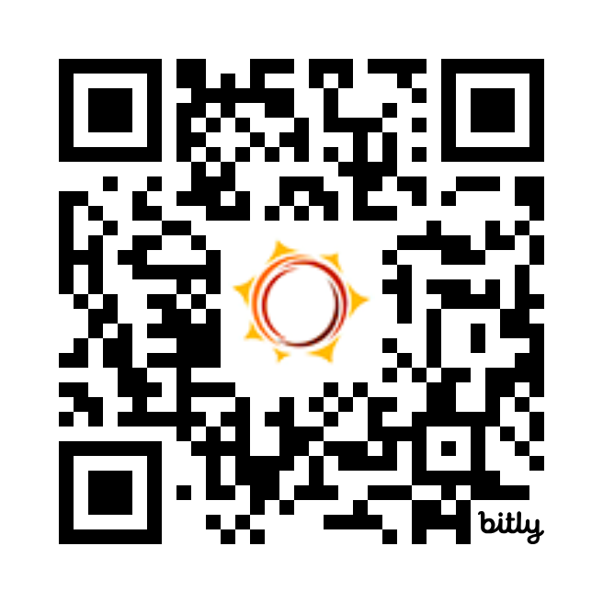
Feedback Survey
Tell us how we did!
Scan the QR code or visit
http://bit.ly/drf_training
to take our Presentation Feedback Survey
Use presentation code: ZW1

