Slide 1
Understanding Florida’s Mental Health System
Presented by:
Aaron Victoria, Advocate-Investigator/PAIMI Program Coordinator
Melissa Cyril, Rights Training and Outreach Coordinator

Slide 2
Accessibility

Slide 3
Caption Options & ASL
Closed Captions: CC button at the bottom of the screen
External Caption Viewer: Link provided in the chat
ASL Interpreters: Spotlighted on your screen

Slide 4
Submitting Questions & Recording
Q and A button: Located at the bottom of the screen
  Email: Webinar@DisabilityRightsFlorida.org
You can submit questions at any time. We will answer them throughout the webinar.
Please try to limit sharing your personal information in the chat or questions. You can reach out to our Agency if you have more specific questions related to your Fair Hearing.
This webinar will be recorded and posted on our website and YouTube channel.

Slide 5
Today’s Presenters (1 of 2)
Aaron Victoria:
Senior Advocate-Investigator with Disability Rights Florida (DRF), Florida’s Protection and Advocacy system.
PAIMI Program Coordinator
Joined DRF in 2020
PhD in Anthropology from the University of Florida (2019)
Notes:
As an AI, I investigate
complaints of abuse, neglect and rights violations throughout facilities in Florida with special attention to individuals with mental illnesses. He also monitors facilities that provide mental health services to ensure that patient rights are being protected.
As the PAIMI program coordinator, I assist with DRF’s yearly PAIMI grant application and also prepare the end of the year PAIMI Performance Report (PPR).

Slide 6
Today’s Presenters (2 of 2)
Melissa Cyril:
Rights Training and Outreach Coordinator with Disability Rights Florida (DRF), Florida’s Protection and Advocacy system.
Joined DRF in 2006
Bachelor’s Degree from Florida State University

Slide 7
Presentation Goals
To provide a basic overview of Florida’s mental health system
To review the types of mental health treatment programs in Florida’s mental health system.
To discuss resources for finding services that are right for you and your family.

Slide 8
Presentation Overview
Florida’s Substance Abuse and Mental Health Program
    What it is
    Overview of mental health program services
Peer-based community resources
Housing options
Resources for finding care and information

Slide 9
Overview of Florida’s Mental Health System:
The Substance Abuse and Mental Health Program
Florida Department of Children and Families (DCF)
Managing Entities

Slide 10
Florida’s Substance Abuse and
Mental Health (SAMH) Program
The single state authority on substance abuse and mental health
Designated by the federal Substance Abuse and Mental Health Services Administration (SAMHSA).
Governed by Chapters 394 and 397 of the Florida Statutes
Responsible for the oversight of a statewide system of care for the prevention, treatment, and recovery of children and adults with serious mental illnesses or substance abuse disorders. (Endnote: 1)
Notes:
The Substance Abuse and Mental Health (SAMH) Program is the single state authority on substance abuse and mental health as designated by the federal Substance Abuse and Mental Health Services Administration (SAMHSA). The program is governed by Chapters 394 and 397 of the Florida Statutes and is responsible for the oversight of a statewide system of care for the prevention, treatment, and recovery of children and adults with serious mental illnesses or substance abuse disorders.

Slide 11
Florida’s Department of
Children and Families (DCF)
The state agency that administers Florida’s Substance Abuse and Mental Health program.
Plans, manages, and evaluates mental health services and supports around the state.
DCF oversees:
  Community mental health centers and programs
  Residential treatment facilities
  Therapeutic Foster Care and Group Homes (Endnote: 2)

Slide 12
Managing Entities (1 of 3)
Managing Entities
“Managing entity” means a corporation selected by and under contract with DCF to manage the daily operational delivery of behavioral health services through a coordinated system of care. Also known as “MEs.”
(3, 4)
Notes:
DCF contracts behavioral health services through regional systems of care called Managing Entities, or MEs.

Slide 13
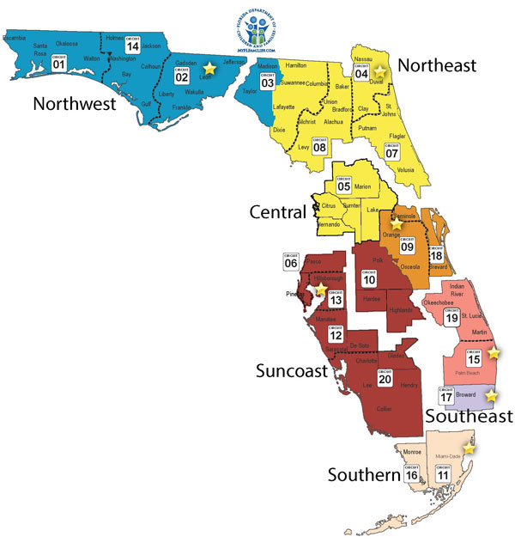
Managing Entities (2 of 3)
7 MEs in Florida:
Big Bend Community Based Care, Inc. d/b/a NWF Health Network (Blue)
Broward Behavioral Health Coalition (Purple)
Central Florida Behavioral Health Network, Inc. (Dark Red)
Central Florida Cares Health System (Orange)
Lutheran Services Florida (Yellow)
Thriving Mind South Florida (South Florida Behavioral Network, Inc.) (Tan)
Southeast Florida Behavioral Health Network (Pink)
Notes:
DCF contracts behavioral health services through regional systems of care called Managing Entities, or MEs.

Slide 14
Managing Entities (3 of 3)
Do not provide direct services, but tailor DCF funding to meet the needs of their specific region of the State.
Contract with service providers in the community.
Responsible for oversight of those service providers.
(3, 4)
DCF
Managing Entity
Identify
Region-specific
needs
Contract
Service Providers
Notes:
MEs do not provide direct services; rather, they allow the DCF’s funding to be tailored to the specific behavioral health needs in the various regions of the State.
These MEs then contract with service providers in the community to provide mental health and substance abuse services to individuals in the community.
The ME is responsible for oversight of those service providers.

Slide 15
Types of Mental Health Treatment Programs in Florida’s Mental Health System:
Community mental health treatment centers
Inpatient Treatment Facilities
Youth Inpatient Treatment Facilities
Community-based Mental Health Services

Slide 16
Community Mental Health
Treatment Centers

Slide 17
Community Mental Health Centers
(1 of 3)
Community Mental Health Centers (CMHC)
Community-based providers who are contracted by MEs and provide services directly to individuals. People who need services get them by going to the CMHCs.
(5, 6)
Notes:
CMHCs are publicly funded, not-for-profits centers. And, again, they operate under contacts with their region’s ME.

Slide 18
Community Mental Health Centers
(2 of 3)
Each CMHC reflects the special needs and resources of the community while providing, at least, the following essential services:
  In-patient services (such as crisis stabilization units)
  Out-patient services (case management, counseling, etc.)
  Day treatment (such as partial hospitalization-day care or night care)
  Emergency services provided 24 hours per day
  (5, 6)
Notes:
Examples:
1.) Community Health of South Florida (Miami)
2.) Central Florida Recovery Center (Orlando)

Slide 19
Community Mental Health Centers
(3 of 3)
Some Benefits of CMHCs:
Provide a varied and comprehensive range of services near the patients' homes (locally).
Provide services to all persons regardless of ability to pay.
Permit a patient to transfer easily from one type of service to another as their needs change (continuity of care).
Strengthen community resources for the prevention of mental illness.
(5, 6)

Slide 20
Inpatient Treatment Facilities

Slide 21
Receiving facilities (1 of 2)
Receiving Facility
A public or private facility or hospital designated by DCF to receive, hold, and provide treatment to involuntary patients under emergency conditions for mental health or substance abuse evaluation.
*The term does not include a county jail.
Fla. Stat. § 394.455
Notes:
Receiving facilities are acute care services that are available 24/7 and is intended to be a brief, intensive alternative to full hospitalization.

Slide 22
Receiving facilities (2 of 2)
Patients arrive under emergency conditions for mental health or substance abuse evaluation.
Provide:
  evaluation and treatment, or
  transportation to an appropriate service provider.
Commonly referred to as “Crisis Stabilization Units (CSU)” or “Baker Act” facilities
  Florida’s Baker Act is also known as “The Florida Mental Health Act,” and is found in Part I of Chapter 394 of the Florida Statutes.
Specially designated by DCF to provide short-term treatment for acute mental health crisis situations. (7, 8)

Slide 23
Short-Term Residential
Treatment Facilities (SRT)
Provide step-down services for residents of CSUs
Allow for more extended, but less intensive level of active treatment for psychiatric conditions
Fill the gap between crisis care and long-term hospitalization in a Residential Treatment Facility
(9, 10)
Notes:
For Example, Peace River Center in Bartow has both a CSU and SRT. They will transfer patients who have been stabilized but still require ongoing treatment from their CSU to the SRT.

Slide 24
State Mental Health
Treatment Facilities (1 of 2)
State Mental Health Treatment Facility (State Hospital)
A state-operated facility designated by DCF to provide extended treatment and hospitalization for individuals with serious mental illness.
A court of law may commit someone to receive involuntary treatment when strict legal criteria are met, including when:
  the symptoms of mental illness put them at substantial risk of self-neglect because they cannot care for themselves or survive on their own using all available supports
  they may “inflict serious bodily harm on self or others” (11, 12, 13)
Notes:
For treatment needs that cannot be met by a short-term stay in a receiving facility or in an outpatient community setting.

Slide 25
State Mental Health
Treatment Facilities (2 of 2)
Civil Clients
committed to receive treatment under the Baker Act (Florida Statutes, Chapter 394)
Forensic Clients
committed to more secure facilities to receive treatment under the Forensic Client Services Act (Florida Statutes, Chapter 916)
  charged with a felony crime but are incompetent to proceed because of their mental illness, or
  adjudicated not guilty by reason of insanity after facing prosecution for a felony crime.
Notes:
State Hospitals include Florida State Hospital, Northeast Florida State Hospital, and South Florida State Hospital
Forensic facilities include North Florida Evaluation and Treatment Center, Treasure Coast Forensic Treatment Facility, South Florida Evaluation and Treatment Facility, and Florida State Hospital has a forensic unit.

Slide 26
Youth Inpatient Treatment Facilities

Slide 27
Statewide Inpatient
Psychiatric Program (SIPP) (1 of 2)
Statewide Inpatient Psychiatric Program (SIPP)
Psychiatric services for youth under 21 years with serious mental illness or emotional disturbance that require inpatient, residential care.
Referrals initiated by a designated staff person in the local DCF District SAMH office with involvement of parent/guardian/family member.
Funded by Medicaid Waiver program.
(14)
Notes:
Similar to the State Hospital setting but for youth under 21 years old.

Slide 28
Statewide Inpatient
Psychiatric Program (SIPP) (2 of 2)
Services Provided:
individual plan of care
crisis intervention
bio-social and or psychiatric evaluation
close monitoring by staff
medication management
(14)
individual, family, and group therapy
routine medical and dental care
certified educational programming
recreational, vocational, and behavior analysis services
connection to community-based services.

Slide 29
Juvenile Incompetent to
Proceed Program (JITP) (1 of 3)
Competency restoration services for youth who are:
  1.) charged with a felony before their 18th birthday
  and
  2.) unable to participate in legal proceedings due to mental illness, intellectual disability, or Autism
* DCF oversees the services
(15)
Notes:
Similar to adults who have been committed to forensic facilities.

Slide 30
Juvenile Incompetent to
Proceed Program (JITP) (2 of 3)
The Goal:
To allow juveniles to return to court to complete proceedings
Achieved by:
Helping each juvenile to become knowledgeable about the delinquency process and their legal situation to ensure appropriate due process.
Notes:
They achieve this by helping each juvenile to become knowledgeable about the delinquency process and their legal situation to ensure appropriate due process.

Slide 31
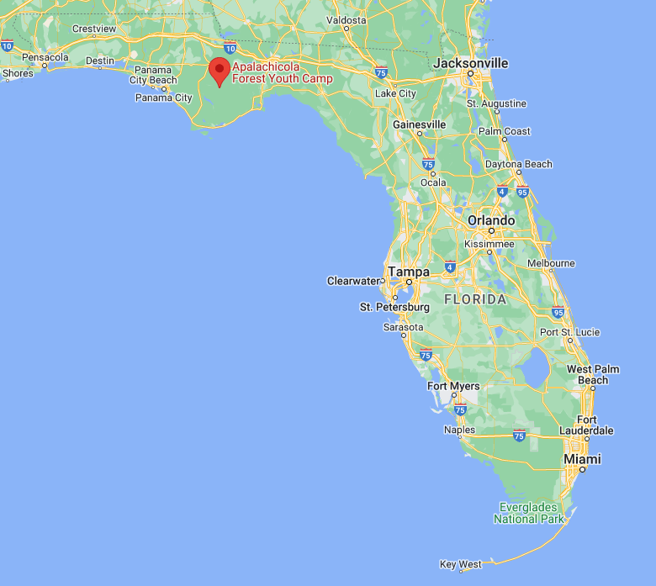
Juvenile Incompetent to
Proceed Program (JITP) (3 of 3)
Community Restoration Services
Home
Detention Center
Juvenile’s School
*Managed by Twin Oaks Forensic Outpatient Services (TOFOS)
Secure Residential Services
Apalachicola Forest Youth Camp (AFYC) located in Liberty County, FL
*Managed by Twin Oaks Juvenile Development, Inc. under contract with DCF

Slide 32
Community-based
Mental Health Services

Slide 33
Florida Assertive Community
Treatment - FACT Teams (1 of 3)
What Is a FACT Team:
An interdisciplinary team that delivers comprehensive care to individuals with serious mental illness while in the community
Who Do FACT Teams Assist:
Adult clients with severe and persistent mental illness
Eligibility determined by MEs with priority given to those with history of repeated:
  Hospitalization or emergency room visits
  Admissions to state hospitals
  Homelessness
  Incarceration
What Is Their Goal:
Assist clients to live as independently as possible in the community
Prevent recurrent hospitalization or incarceration (16, 17)
Notes:
The FACT program is recovery-oriented, strengths-based, and person-centered.
They can provide services where their clients live, work, or at other preferred settings.
They are available 24/7.

Slide 34
Florida Assertive Community
Treatment - FACT Teams (2 of 3)
How Do FACT Teams Assist:
Provide 24/7 individualized, wrap-around outpatient care plans.
Care Plans include:
  Psychiatric services and supportive therapies
  Case management
  Primary medical care
  Financial supports and money management services
  Transportation
  Training for family members and supporters
*43 FACT Teams total, availability varies by ME
Notes:
To make an appointment with a FACT team, contact the Managing Entity in your area.
Ask for experience working with a FACT team.

Slide 35
Florida Assertive Community
Treatment - FACT Teams (3 of 3)
Community Action Treatment (CAT) Teams:
Similar to FACT Teams but for children and young adults
Contact the ME in your area for an appointment
  2025: 71 CAT Teams total, availability varies by ME
Notes:
To make an appointment with a FACT team, contact the Managing Entity in your area.
Ask for experience working with a FACT team.

Slide 36
Mobile Response Teams (1 of 3)
What is a Mobile Response Team:
Team of professionals that provide 24/7 emergency behavioral health care on-site to anyone at any place in the state of Florida
Who Do Mobile Response Teams Assist:
Anyone, regardless of their ability to pay
Available 24/7 in any setting that the behavioral health crisis is occurring.
Assistance requested by calling MRT phone number.
What Are Their Goals:
Lessen trauma
divert from emergency departments or juvenile/criminal justice
prevent unnecessary psychiatric hospitalizations. (18)

Slide 37
Mobile Response Teams (2 of 3)
How Do Mobile Response Teams Assist:
Receive calls from individuals experiencing a mental health crisis
Provide immediate assessment, intervention, recommendations, referrals and support services.
Link individuals to appropriate community resources.

Slide 38
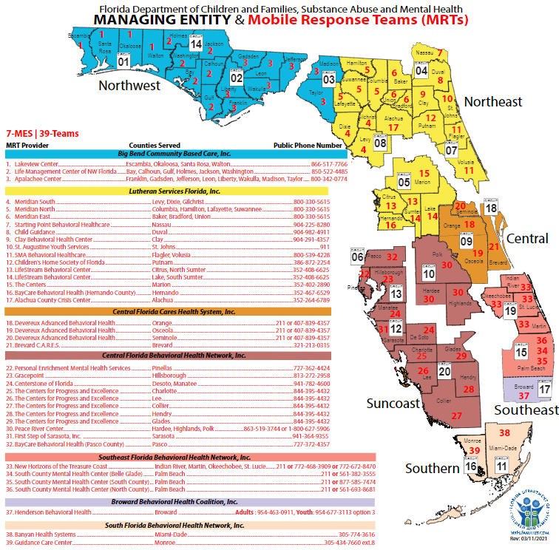
Mobile Response Teams (3 of 3)
Link: https://www.myflfamilies.com/sites/default/files/2022-11/MRT.pdf
Notes:
Ask for experience with contacting a MRT.

Slide 39
Coordinated Specialty Care (CSC) for Early Psychosis (1 of 3)
Who Do CSCs Assist:
People with first episode psychosis (FEP)
What Are Their Goals:
Develop recovery-oriented treatment programs
Link individuals with services as soon as possible after psychotic symptoms begin
  (19)
Notes:
A recovery-oriented treatment program where a team of specialists work with people with first episode psychosis.

Slide 40
Coordinated Specialty Care (CSC) for Early Psychosis (2 of 3)
How Do CSCs Assist:
Teams of specialists use shared decision making to work with individuals undergoing FEP to create a personal treatment plan.
Personal Treatment Plans include:
  Psychotherapy
  Medication management specially tailored to FEP
  Family education and support
  Case management
  Work education or support

Slide 41
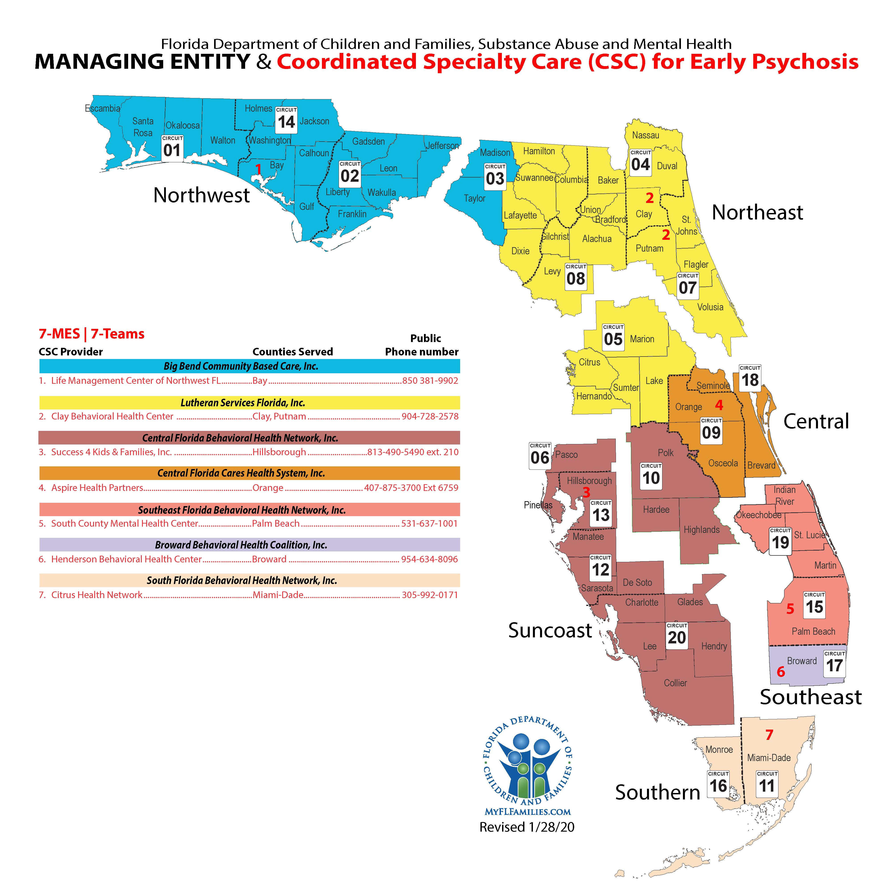
Coordinated Specialty Care (CSC) for Early Psychosis (3 of 3)
Link: https://www.myflfamilies.com/document/4676
Notes:
There is one designated CSC under each ME, meaning that service could be sparse in larger region, such as the pan-handle.
Ask for experience with contacting an MRT.

Slide 42
Peer-based Community Resources:
Peer Support
Drop-in Centers
Clubhouses
Peer Respite and Warmlines

Slide 43
Peer Support
Peer Support
A system of giving and receiving help founded on key principles of respect, shared responsibility, and mutual agreement of what is helpful.
Peer supporters may be found in a variety of settings, such as:
  CSUs
  State Hospitals
  Drop-In Centers
  Clubhouses
  Warmlines and Crisis Lines
  (20, 21, 22)
Notes:
Not based on psychiatric models and diagnostic criteria, but understanding another’s situation empathetically through the shared experience of emotional and psychological pain.

Slide 44
Florida Certified Recovery
Peer Support Specialist (CRPS) (1 of 2)
What is a CRPS:
A special designation awarded by the Florida Certification Board (FCB) to those who have undergone special training.
A specialist who uses their lived experience and training to help others with mental health and/or substance abuse conditions.
Training includes: Recovery Support, Advocacy, Mentoring, Professional Responsibilities

Slide 45
Florida Certified Recovery
Peer Support Specialist (CRPS) (2 of 2)
Who Qualifies As A CRPS:
Anyone who:
  Self-identifies as a person who has direct personal experience living in recovery from mental health and/or substance use conditions,
  Has a desire to use their experiences to help others with their recovery,
  Is willing to publicly identify as a person living in recovery for the purpose of educating, role modeling, and providing hope to others about the reality of recovery, and
  Has had the proper training and experience to work in a provider role.
(20, 21, 22)

Slide 46
Drop-in Centers (1 of 2)
What Are Drop-In Centers:
Centers where people with serious and persistent mental illnesses can independently develop, operate, and participate in social, recreational, and networking activities.
Provide support from peer volunteers
Hours also vary by location, but frequently offer availability on evenings, weekends, and holidays when volunteers are available.

Slide 47
Drop-in Centers (2 of 2)
Services Provided:
Vary by location, but can include things like:
Self-help or mutual support meetings, outreach to those in facilities
On-site activities (e.g. arts and crafts, socials, or guest speakers)
Off-site excursions to do fun things (e.g. go to the movies)
Access to computers and employment support
Advocacy for individuals and with systems
Basic needs assistance (e.g. a clothing bank)
A small business at the center (e.g. a snack shop or thrift store)
  (23)

Slide 48
Clubhouses (1 of 3)
Clubhouses
Voluntary organizations run by and for members with the support of staff where members participate in consensus-based decision-making regarding all important matters relating to the running of the Clubhouse.

Slide 49
Clubhouses (2 of 3)
What Are the Goals of Clubhouses:
Provide a restorative environment for individuals whose lives have been severely disrupted because of their mental illness.
Apply an evidence-based model to promote recovery and prevent (re)hospitalization of members.
Use a work-ordered day in which recognize and utilize the talents and abilities of members within the Clubhouse.
Notes:
Primary goal: To provide a safe place for adults in the community with mental illness to learn, socialize, and support one another in their journey to healing.

Slide 50
Clubhouses (3 of 3)
Services Provided:
Opportunities to obtain paid employment in the local labor market through a Clubhouse-created Transitional Employment Program.
Opportunities to participate in Clubhouse-supported and Independent programs.
Assistance in accessing community-based educational resources.
(24)
Access to crisis intervention services, when needed.
Evening/weekend social and recreational events.
Assistance in securing and sustaining safe, decent and affordable housing.

Slide 51
Respite Care and Warm Lines (1 of 3)
Warm Lines
A peer-run hotline that offers callers emotional support that can prevent a crisis. Warm Lines are staffed by volunteers who are in recovery themselves.
Example:
Mental Health America SETH Line
954-578-5640
Hours: Monday – Friday, 6 – 10pm

Slide 52
Respite Care and Warm Lines (2 of 3)
  Hotlines vs. Warmlines
For callers in immediate crisis
For callers needing emotional support to prevent future crisis

Slide 53
Respite Care and Warm Lines (3 of 3)
What Is Respite Care:
System of temporary supports and relief for families caring for a family member who might otherwise require permanent placement in a facility.
Options for residential, daycare, and in-home services.
Example: Federation of Families of Central Florida
  (25, 26)

Slide 54
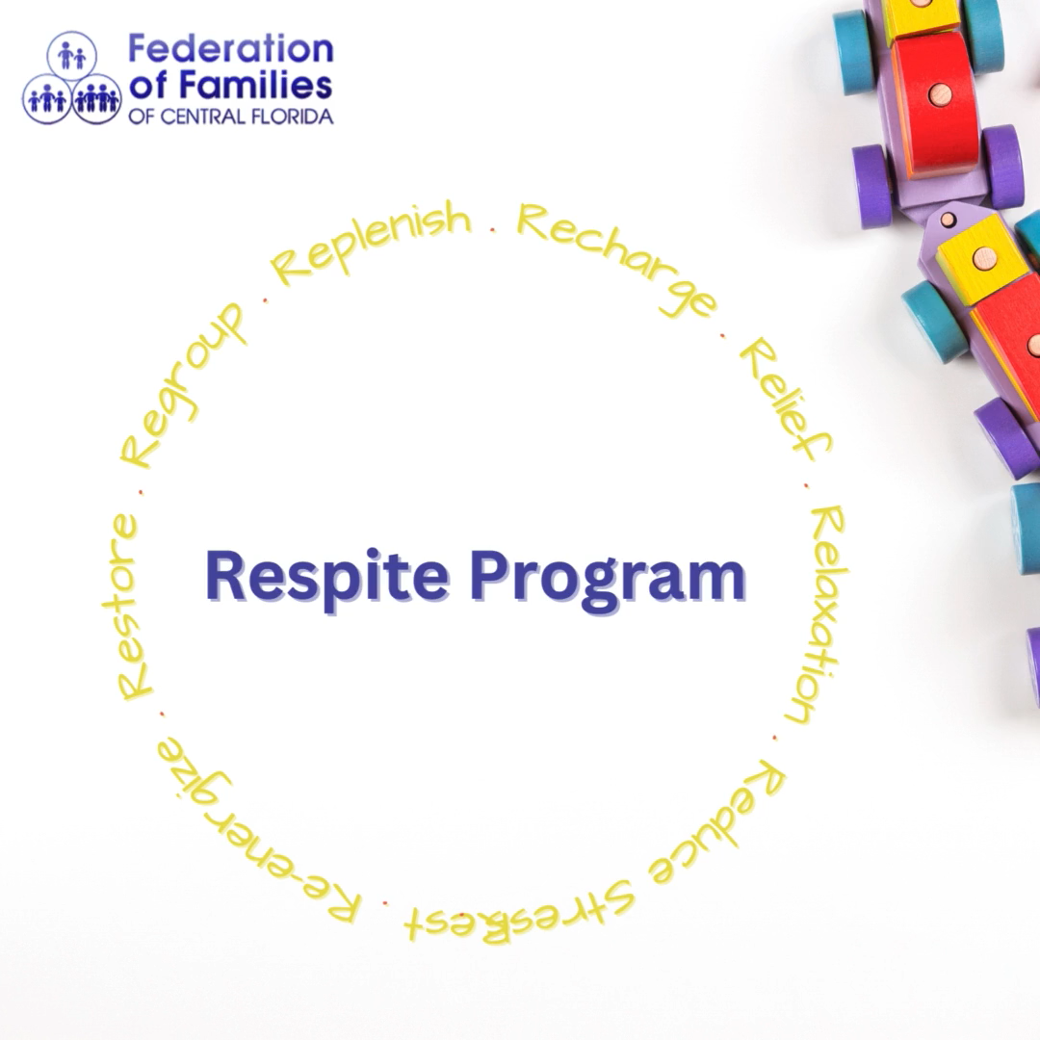
Federation of Families of Central Florida

Slide 55
Housing Options:
Supportive Housing
Adult Family Care Homes
Limited Mental Health ALFs

Slide 56
Supportive Housing (1 of 2)
Supportive Housing
Affordable, community-based housing with flexible, voluntary support services for individuals and families living with mental illness.
Their Goal:
Combine affordable housing with community-based services so that people can live in their own, individual apartment or residence.

Slide 57
Supportive Housing (2 of 2)
On-Site Services May Include:
Case management
Day Treatment
Drop-In or Self-Help Centers
Clubhouses
(27)
Crisis and Emergency Support
FACT teams
Recovery support

Slide 58
Adult Family Care Homes (1 of 2)
Adult Family Care Home
Residential home designed to provide personal care services to individuals requiring assistance.
*Licensed by Florida’s Agency for Health Care Administration (AHCA)
(28)

Slide 59
Adult Family Care Homes (2 of 2)
What Do Adult Family Care Homes Look Like:
No more than five “disabled adults or frail elders” who are not relatives.
The person who owns or rents the home provides room, board, and personal care, on a 24-hour basis.
The adult family-care home provider must live in the home.
Mental health overlay program services may be provided in an Adult Family Care Home to provide additional evaluation and supplemental onsite services for individuals with mental illness.

Slide 60
Limited Mental Health
Assisted Living Facilities (1 of 2)
Limited Mental Health ALF
A residential facility that provides housing, meals, and one or more personal services for individuals that live there.
*Licensed by Florida’s Agency for Health Care Administration (AHCA)

Slide 61
Limited Mental Health
Assisted Living Facilities (2 of 2)
What Do Limited Mental Health ALFs Look Like:
Wide variety: Homes with less than a dozen individuals to larger, more institutional-like facilities.
Residents have a community living support plan that includes access to mental health services. (e.g., medication management and therapeutic activities.
Staff must be trained and equipped to assist residents in carrying out activities identified in their community living support plans.
Like Adult Family Care Homes, residents may receive mental health overlay program services onsite. (29)

Slide 62
Disability Rights Florida:
Who is Disability Rights Florida
What resources do they provide

Slide 63
Disability Rights Florida (1 of 4)
What Does Disability Rights Florida Do
Advocates, educates, investigates, and litigates to protect and advance the rights, dignity, equal opportunities, self-determination and choices for all people with disabilities.
How Do They Achieve This:
Our legally-based advocacy services are provided by multidisciplinary teams of attorneys, advocates, investigators, paralegals, intake specialists and other professionals.
* All services are free and confidential.

Slide 64
Disability Rights Florida (2 of 4)
If you are an individual with a disability and have questions about your legal rights relating to mental health services, or you want to request an investigation into the abuse or neglect of an individual receiving mental health treatment in a facility, please contact us to make a request for service.
(800) 342-0823 (Toll-free Phone)
(800) 346-4127 (TDD)
Online - https://disabilityrightsflorida.org/intake
www.disabilityrightsflorida.org
Notes:
Select option 3 to access DRF’s intake line.

Slide 65
Disability Rights Florida (4 of 4)
PAIMI Advisory Council (PAC)
Primary goal is to oversee and provide input on DRF’s PAIMI-related work, or the work directed towards people with mental illness.
Members must have experience with mental illness
Membership terms are 4 years
New PAC member applicants reviewed and interviewed by PAC Nominating Committee throughout the year
IF INTERESTED IN BECOMING A PAC MEMBER
Submit an application online at https://disabilityrightsflorida.org/about/paimi_advisory_council
OR
Pick up a printed PAC application on your way out the door
Notes:
Goals: Informing DRF about urgent concerns in the mental health community, working with DRF’s Governing Board to develop their GPOs, and educating the public about the mission of the P&A system.
Requirements: People who have received or are receiving mental health services or are family members of someone who has/does, attorneys and MH professionals, MH providers, people who are knowledgeable about MIs with a demonstrated commitment to improving MH services in Florida.
Melissa and I will be hanging around if anyone would like more information about the PAC

Slide 66
DRF Public Input Survey
Your input matters to us!
Please visit the link below between to complete our annual
DRF Public Input Survey.
Your responses will help us plan our goals, priorities, and objectives for 2026.
www.DisabilityRightsFlorida.org/Survey

Slide 67
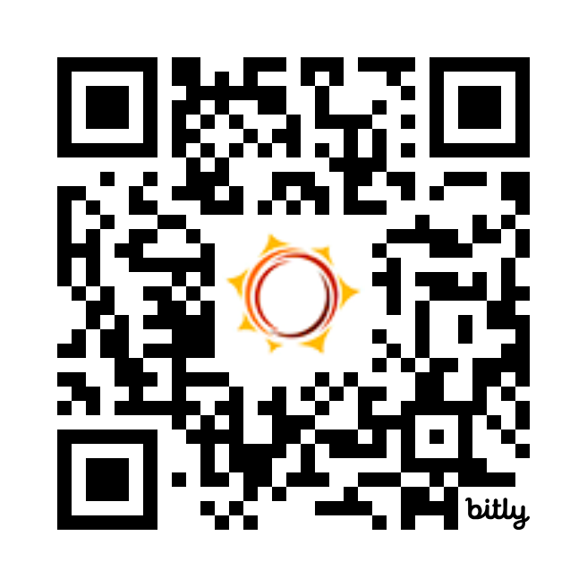
Feedback Survey
Tell us how we did!
Scan the QR code or visit
http://bit.ly/drf_training
to take our Presentation Feedback Survey
Use presentation code: ZW6

Slide 68
References (1 of 4)
DCF website, accessed 5-24-2023, https://www.myflfamilies.com/services/substance-abuse-and-mental-health
DCF website, accessed 5-24-2023, https://www.myflfamilies.com/services/substance-abuse-and-mental-health/adult-mental-health, https://www.myflfamilies.com/services/substance-abuse-and-mental-health/childrens-mental-health-program
DCF website, Managing Entities, accessed 5-23-2023, https://www.myflfamilies.com/services/substance-abuse-and-mental-health/samh-providers/managing-entities
§ 394.9082, Fla. Stat.
CMS, Community Mental Health Centers, accessed 5-23-2023, https://www.cms.gov/Medicare/Provider-Enrollment-and-Certification/CertificationandComplianc/CommunityHealthCenters
DCF website, accessed 5-23-2023, https://www.myflfamilies.com/services/substance-abuse-and-mental-health/adult-mental-health
§ 394.455 (40), Fla. Stat.
DCF website, accessed 5-24-2023, https://www.myflfamilies.com/crisis-services, AHCA website, accessed 5-24-2023, https://ahca.myflorida.com/health-care-policy-and-oversight/bureau-of-health-facility-regulation/hospital-outpatient-services-unit/crisis-stabilization-units

Slide 69
References (2 of 4)
DCF website, accessed 5-23-2023, https://www.myflfamilies.com/services/substance-abuse-and-mental-health/substance-abuse-mental-health-treatment-services-and-1-1, AHCA website, accessed 5-23-2023, https://ahca.myflorida.com/health-care-policy-and-oversight/bureau-of-health-facility-regulation/hospital-outpatient-services-unit/crisis-stabilization-units (section on SRTs)
Rule 65E-12.103(27), Fla. Admin Code, available online at https://www.flrules.org/gateway/readFile.asp?sid=0&tid=20227136&type=1&file=65E-12.103.doc
§ 394.455, Fla. Stat.
§ 916.13, Fla. Stat.
§ 394.467, Fla. Stat.
§ 394.4781, Fla. Stat.
DCF website, accessed 5-23-2023, https://www2.myflfamilies.com/service-programs/samh/juvenile-incompetent-to-proceed/
DCF website, accessed 5-23-2023, https://www2.myflfamilies.com/service-programs/samh/adult-mental-health/sos/treatment.shtml

Slide 70
References (3 of 4)
The critical ingredients of assertive community treatment, published in World Psychiatry by Gary R. Bond and Robert E. Drake, available online at: https://www.ncbi.nlm.nih.gov/pmc/articles/PMC4471983/
DCF Office of SAMH - Guidance 34 – Mobile Response Team (MRT), accessed 5-23-2023, https://www2.myflfamilies.com/service-programs/samh/managing-entities/2022/IncDocs/Guidance%2034%20MRT%202021%2008%2001.pdf
National Institute for Mental Health website, accessed 5-23-2023, https://www.nimh.nih.gov/health/topics/schizophrenia/raise/what-is-coordinated-specialty-care-csc
Peer Support Coalition of Florida website, accessed 5-23-2023, https://www.peersupportfl.org/who-we-serve/peer-specialists/
§ 397.417, Fla. Stat.
Florida Certification Board website, accessed 5-23-2023, https://flcertificationboard.org/certifications/certified-recovery-peers-specialist/
DCF website, accessed 5-23-2023, https://www2.myflfamilies.com/service-programs/samh/adult-mental-health/sos/support.shtml

Slide 71
References (4 of 4)
24) Clubhouse International website, accessed 5-23-2023, https://clubhouse-intl.org/what-we-do/what-clubhouses-do/
Federation of Families of Central Florida, accessed 5-12-2023, http://https://www.ffcflinc.org/
Warmlines.org website, accessed 5-23-2023, https://warmline.org/
DCF Office of SAMH - Guidance 21 – Housing Coordination, available online at: https://www2.myflfamilies.com/service-programs/samh/managing-entities/2022/IncDocs/Guidance%2021%20Housing%202020%2007%2001.pdf
§ 429.60, Fla. Stat., et seq.
§ 429.075, Fla. Stat.

